Slide 1
STM32
Training Hands on and Tools overview

Slide 2
Tools Overview
Evaluation Boards
Free IDEs
AC6
CoIDE
Keil (M0/M0+)
mbed
Ecosystem
STM32CubeMX
STLink Utility
ST Visual Programmer (STVP)
STM32 Flash Loader Demonstrator
Dfuse
STM Studio

Slide 3

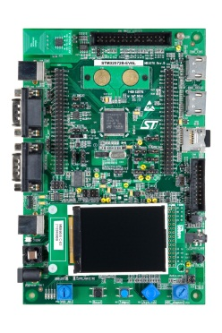
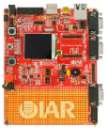
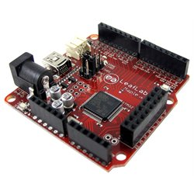
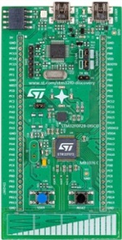
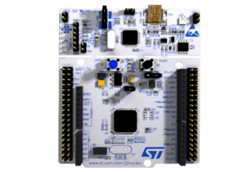
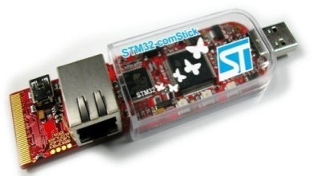

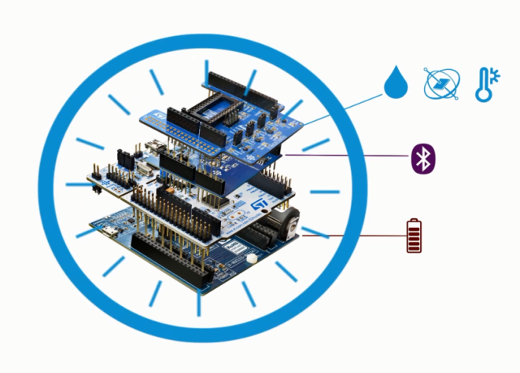







Broad Range of Development Tools
STM32 Nucleo
Discovery kits
Evaluation boards
3rd parties
Flexible prototyping
Key feature prototyping
Full feature evaluation
From full evaluation to open hardware
www.st.com/stm32nucleo
www.st.com/stm32discovery
STM32 Nucleo expansion boards
Specialized functionality add-on
Connectivity, Sensors…
www.st.com/x-nucleo
Notes:
Various types of development boards enable you to get started with the STM32 microcontrollers.
* The STM32 Nucleo boards provide an affordable and flexible way for anyone to try out new ideas and build prototypes with a wide choice of specialized expansion boards.
* The Discovery kits enable users to seamlessly exercise key features of STM32 products, while the Evaluation board exposes all MCU functionalities.
All these development boards include an integrated debugger/programmer as well as a comprehensive software library with examples that help developers to take davantage of STM32 capabilities.

Slide 4
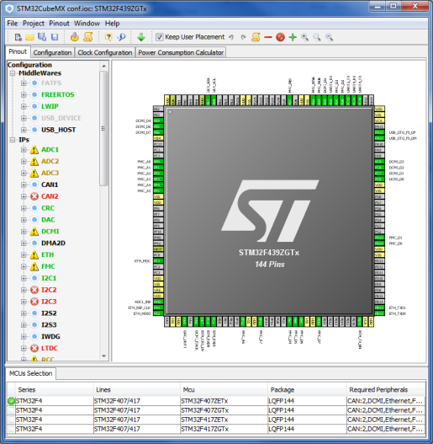
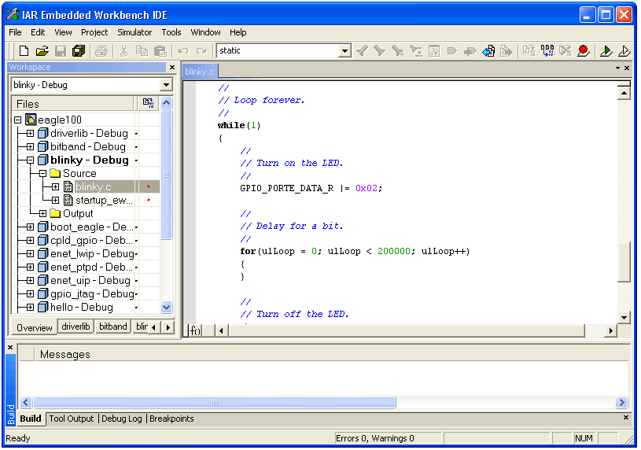
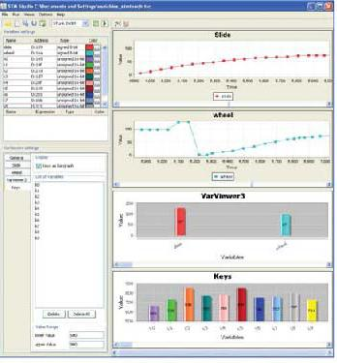

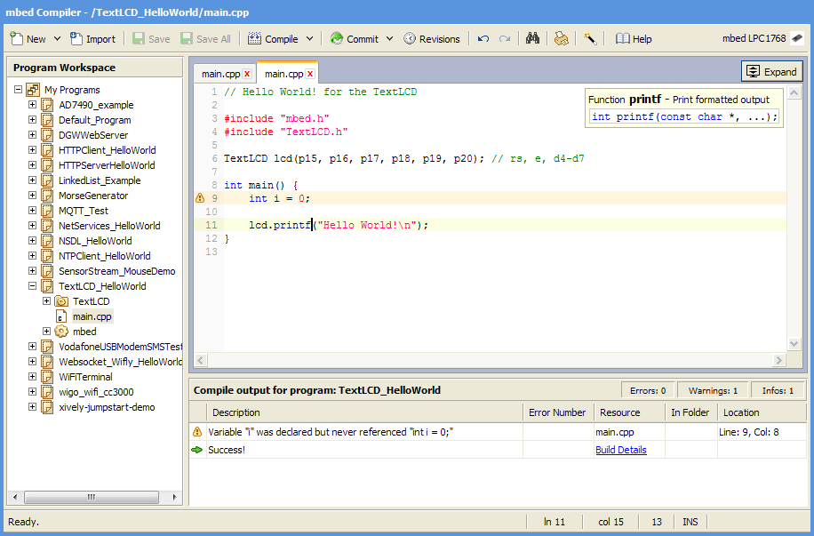








Comprehensive choice of IDEs
STM32CubeMX
Partners IDEs
STMStudio
Generate Code
Compile & Debug
Monitor
Free IDE

Slide 5
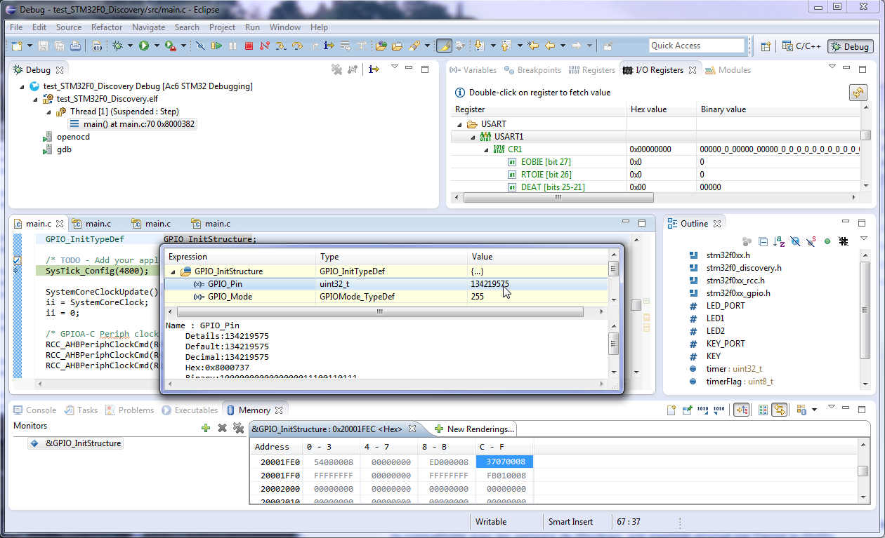
System Workbench for STM32
Free Eclipse-based flexible software development environment :
Covers the full range of STM32 mcus and associated boards (Nucleo, Discovery, Eval).
Comprehensive support for STM32 firmware (Standard Peripheral library or Cube HAL).
Customisation enabled through Eclipse plug-ins (SVN, EGit…).
Key features :
GCC C/C++ compiler.
GDB-based debugger.
ST-Link support.
Multi-OS support : Windows, Linux & OSX (Q2’2015).
No code size limit.
SW4STM32 project format will be supported by CubeMX.

Slide 6
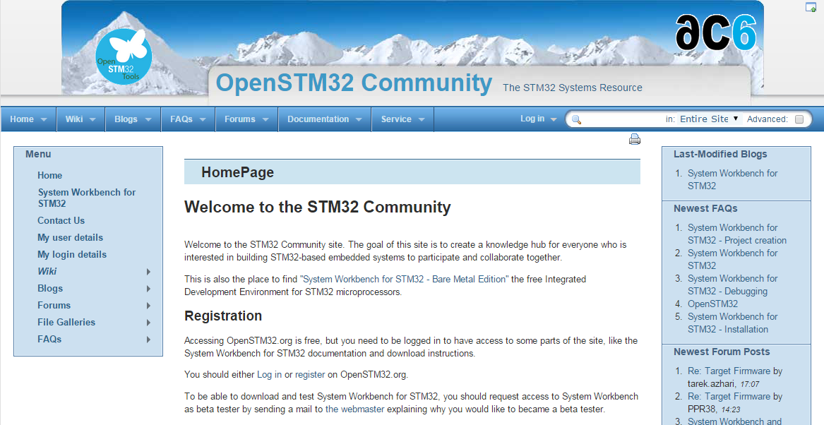
System Workbench for STM32
How to download SW4STM32 ?
Go to associated collaborative site at www.openstm32.org
Register to this site.
Get installation instructions at the Documentation > System Workbench page.
Proceed with immediate download of the toolchain.
Technical support :
Handled through the associated Openstm32 website.
Documentation, forum, blog, trainings are available to provide assistance to users.

Slide 7

CoIDE
Free Eclipse-based simplified software development environment:
Supports all STM32 mcus and Nucleo boards.
Supports STM32Cube firmware (HAL).
Download and Technical support available through collaborative site at www.coocox.org
Key features :
GCC C/C++ compiler.
GDB-based debugger.
No code size limit.
ST-Link support.
English and Chinese languages are supported.

Slide 8

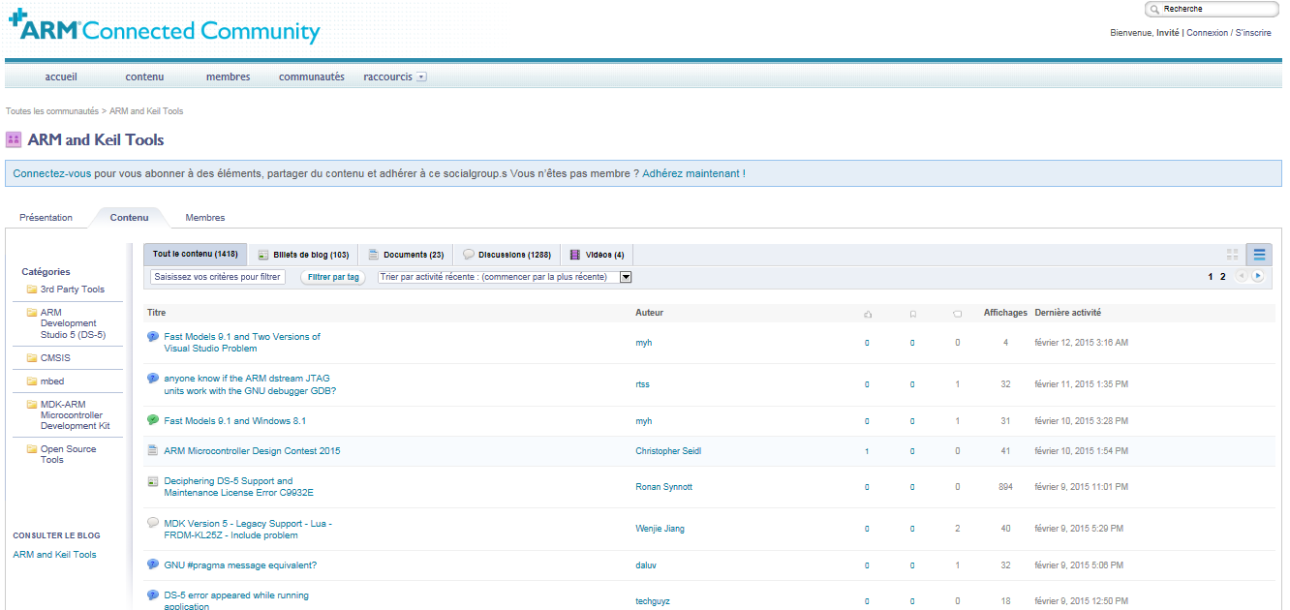
MDK-ARM
Comprehensive software development environment for Cortex-M devices :
Free version for ST supports all STM32F0 and STM32L0 mcus and associated boards (Nucleo, Discovery, Eval).
Comprehensive support for STM32 firmware (Std Peripheral library or Cube HAL).
Technical support available through the ARM Connected Community site at community.arm.com
Key features :
ARM C/C++ compiler.
uVision IDE, debugger and simulation environment.
CMSIS-compliant.
ST-Link support.
English, Chinese, Japanese, Korean languages are supported.
The setup of peripherals configured by CubeMX is directly exported to MDK.

Slide 9
Free MDK-ARM for ST
Free licenses for STM32 devices based on Cortex-M0/M0+ cores :
Applicable immediately to all STM32F0 and STM32L0 mcus.
PC-locked multi-year licenses.
No code size limit.
Multiple language support.
Technical support included.
Direct download from Keil website :
No limit of number of downloads by customer.
Direct access to configuration files for STM32 and associated boards.
Free access to MDK-ARM periodic updates.
How to get free MDK-ARM licenses for STM32F0 and STM32L0 ?
Go to Keil website at : www.keil.com/mdk-st
Download MDK-ARM toolchain.
Activate the free license using this Product Serial Number (PSN) : U1E21-CM9GY-L3G4L

Slide 10



Comprehensive choice of STM32 free IDEs
System Workbench
CoIDE
MDK-ARM
Q2’2015
Q2’2015
Free licenses for all STM32 microcontrollers
Free licenses for STM32F0 & STM32L0
Free access to all STM32Nucleo users

Slide 11
STM32Snippets: A Low Level Coding Package

Slide 12



STM32 Embedded Software Offer - Overview
Abstraction Level
Virtual Machines
With partners
.Net, Java
IS2T, Oracle, Mountainer, .…
Mbed Core
« C » partners
Micrium, SEGGER,
HCC, ….
STM32Cube
Standard Peripheral Libraries
STM32Snippets
Portability Level
STM32 Device
-specific
f.i.: STM32F072
STM32 Series
-specific
f.i.: STM32F1
STM32 Family
-specific
Cortex-M based
MCUs
-specific
Any MCU
Beyond MCU
world
ST Offering. Free
Partners Offer

Slide 13

STM32Snippets
What is it ?
A collection of code examples, directly based on STM32 peripheral registers, available in documentation and as software bundles
Target Audience
low level embedded system developers, typically coming from an 8 bit background, used to assembly or C with little abstraction
Features:
Highly Optimized
Register Level Access
Small code expressions
Closely follows the reference manual
Debugging close to register level
Limitations:
Specific to STM32 devices, not portable directly between series
Not matching complex peripherals such as USB
Lack of abstraction means developers must understand peripheral operation at register level
Available (today) on STM32 L0 and F0 series
Portability | Optimization (Memory & Mips) | Easy | Readiness | Hardware coverage
 | +++ |  |  | +

Slide 14

Standard Peripheral Libraries (SPL)
What is it ?
Collection of C Libraries covering STM32 peripherals
Target Audience
Embedded systems developers with procedural C background. All existing STM32 customer base prior to the STM32Cube launch, willing to keep same supporting technology for future projects, and same STM32 series.
Features:
Average optimization, fitting lots of situations
No need for direct register manipulation
100% coverage of all peripherals
Easier debugging of procedural code
Extensions for complex middleware such as USB/TCP-IP/Graphics/Touch Sense
Limitations:
Specific to certain STM32 series.
No common HAL API prevents application portability between series
Middleware libraries may not be unified for each series
Doesn’t support forward STM32 series starting with STM32 L0 and F7
Portability | Optimization (Memory & Mips) | Easy | Readiness | Hardware coverage
++ | ++ | + | ++ | +++

Slide 15



STM32Cube - Embedded software
What is it ?
Full featured packages with drivers, USB, TCP/IP, Graphics, File system and RTOS
Set of common application programming interfaces, ensuring high portability inside whole STM32 family
User code
STM32Cube
Middleware
STM32Cube
STM32 Hardware abstraction layer
Target Audience
Embedded system developers with a strong structured C background. New customers looking for a fast way to evaluate STM32 and easy portability
Features:
High level and functional abstraction
Easy port from one series to another
100% coverage of all peripherals
Integrates complex middleware such as USB/TCP-IP/Graphics/Touch Sense/RTOS
Can work with STM32CubeMX tool on the PC to generate initialization code
Limitations:
May be challenging to low level C programmers in the embedded space.
Higher portability creates bigger software footprints or more time spent executing adaptation code
Not Available (today) on STM32 F1 series
Portability | Optimization (Memory & Mips) | Easy | Readiness | Hardware coverage
+++ | + | ++ | +++ | +++

Slide 16
ST Embedded software offer – Comparison
Offer | Portability | Optimization (Memory & Mips) | Easy | Readiness | Hardware coverage
STM32Snippets |  | +++ |  |  | +
Standard Peripheral Library | ++ | ++ | + | ++ | +++
STM32Cube | +++ | + | ++ | +++ | +++

Slide 17
ST Embedded software offer - Positioning
Abstraction Level
Libraries, released independently
STM32Cube Embedded Software packages
STM32Cube Middleware level
TCP/IP
RTOS
TCP/IP
USB
Host / Device
Gfx
FAT
File
Sys.
RTOS
Touch
USB
Host / Device
FAT
File
Sys.
Touch
Gfx
STM32Cube HAL
(Hardware Abstraction Layer)
Standard Peripheral Libraries
STM32Snippets
Portability Level
STM32 Device
-specific
f.i.: STM32F072
STM32 Series
-specific
f.i.: STM32F1
STM32 Family

Slide 18










Availability
Offer | Available for STM32
STM32Snippets | Now | N.A. | N.A. | N.A. | N.A. | N.A. | Now | N.A. | N.A.
Standard Peripheral Library | Now | Now | Now | Now | Now | N.A. | N.A. | Now | N.A.
STM32Cube | Now | Now | Now | Now | Now | June 15 | Now | Now | Sept 15

Slide 19
STM32Cube Ecosystem

Slide 20








STM32CubeTM Introduction
20
STM32CubeTM includes:
A configuration tool, STM32CubeMX generating initialization code from user choices
Firmware offering, delivered per series (like STM32CubeF4) with:
An STM32 Abstraction Layer embedded software: STM32Cube HAL
A consistent set of Middleware: RTOS, USB, TCP/IP, Graphics, …
Initialization Code generation based on user choices
STM32CubeMX
STM32Cube HAL: Portable API within all series - Middleware stacks when applicable: RTOS, USB, TCP/IP, Graphics, …
STM32CubeL0
STM32CubeF4
STM32CubeL1
STM32CubeF0
STM32CubeF2
STM32CubeF1
STM32CubeF3

Slide 21
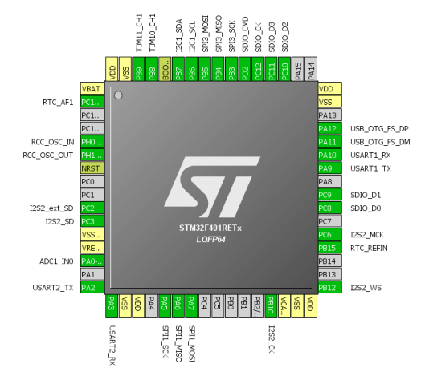
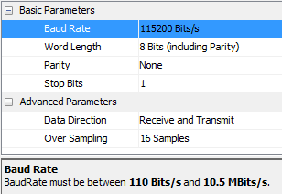


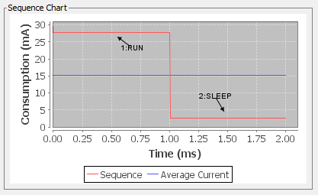
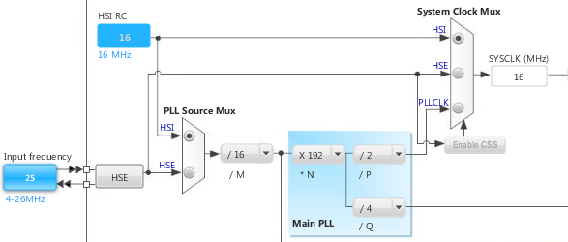
STM32CubeMX
21
Pinout Wizard
Peripherals & Middleware
Wizard
Power Consumption
Wizard
Clock Tree wizard

Slide 22

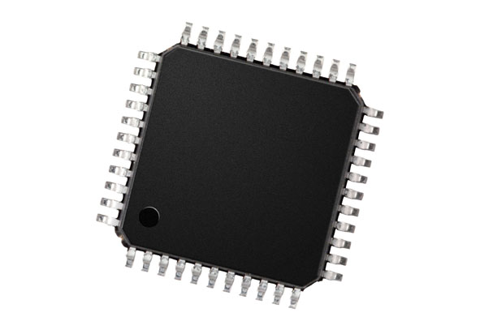
STM32CubeMX
22
Generates Initialization C Code
based on user choices !

Slide 23
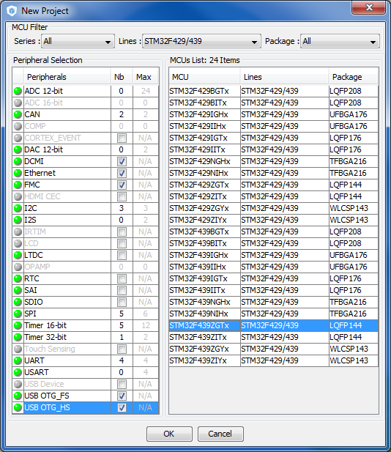
STM32CubeMX: MCU Selector
Filter by:
Series
Line
Package
Peripherals

Slide 24
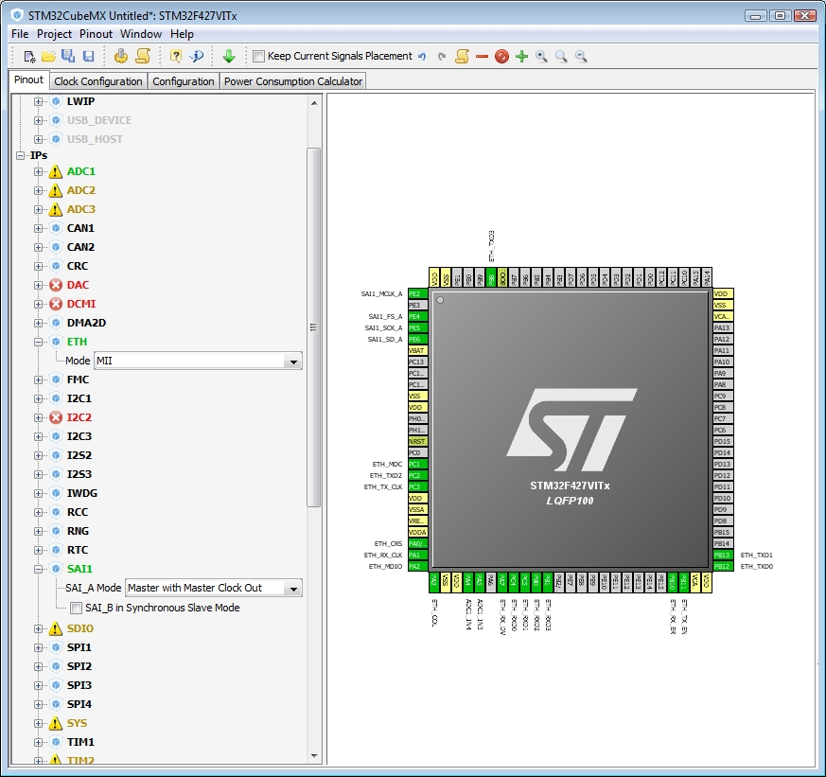
STM32CubeMX: Pin-out configuration
Pinout from:
Peripheral tree
Manually
Automatic signal remapping
Management of dependencies between peripherals

Slide 25
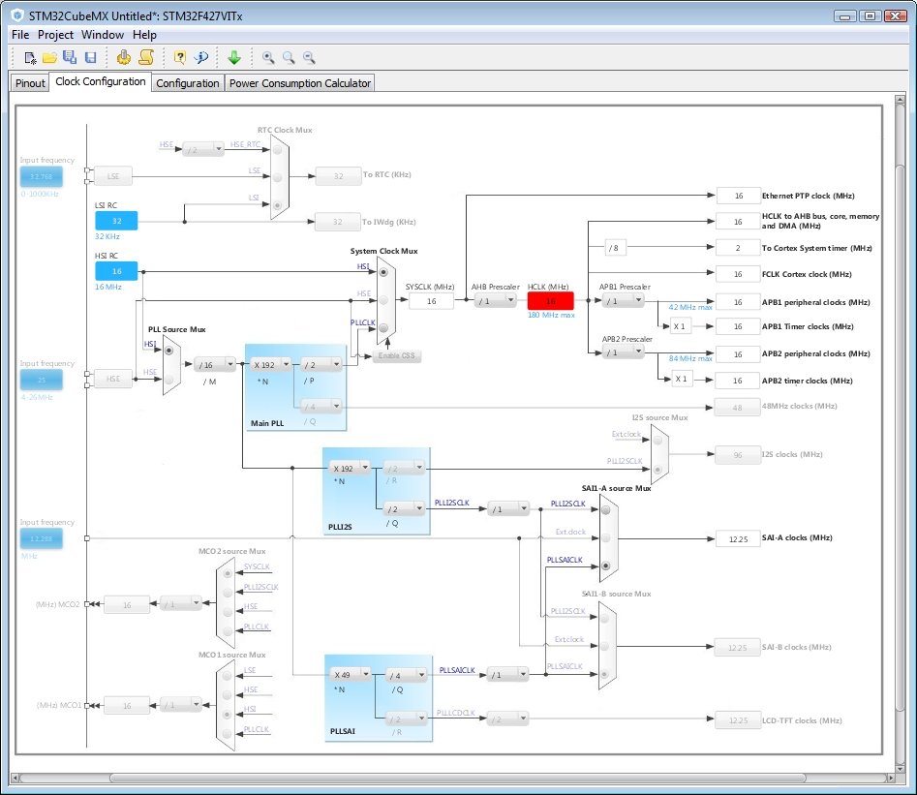
STM32CubeMX: Clock tree
Immediate display of all clock values
Management of all clock constraints
Highlight of errors

Slide 26
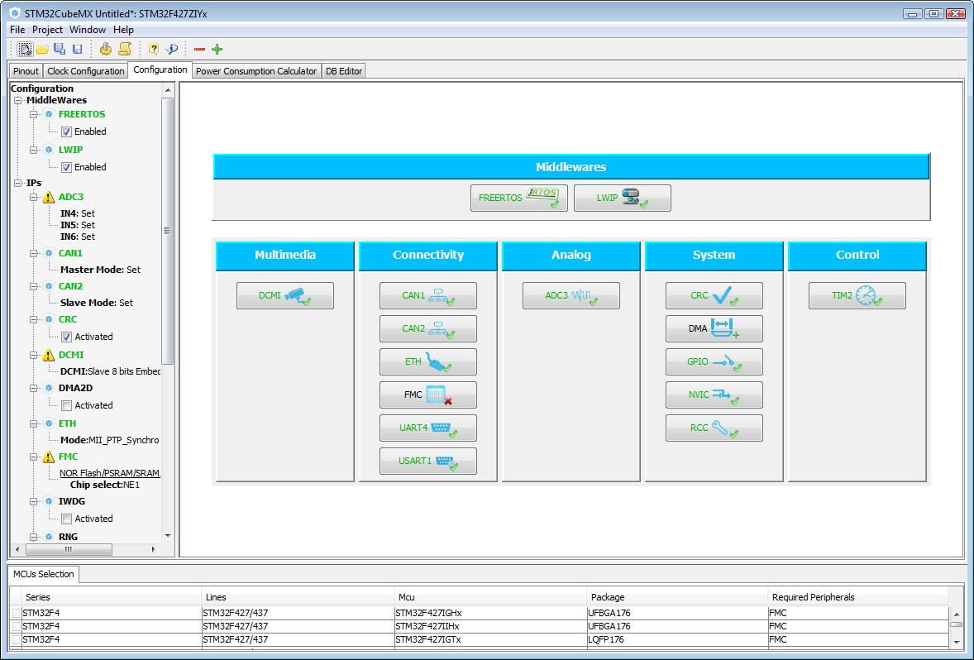
STM32CubeMX: Peripheral configuration
Global view of used peripherals and middleware
Highlight of configuration errors
Manage:
GPIO
Interrupts
DMA

Slide 27
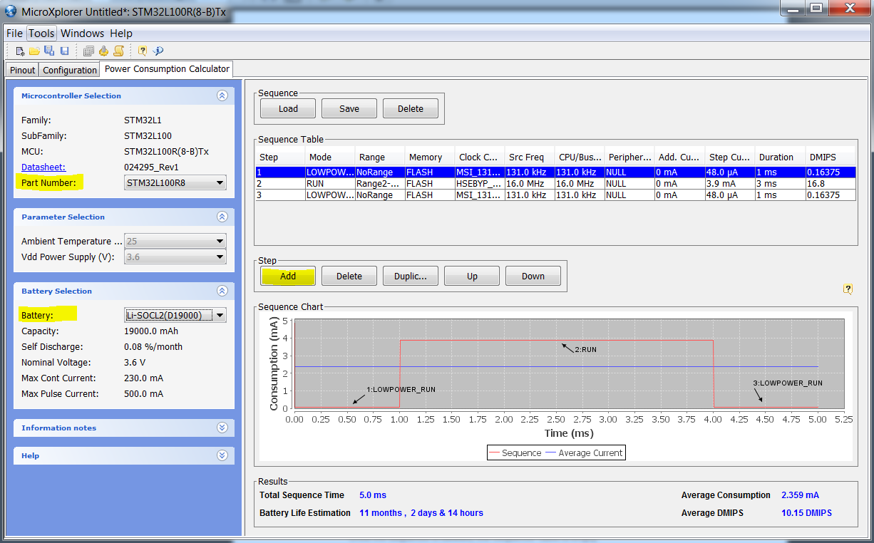
Power consumption calculator
Power step definitions
Battery selection
Creation of consumption graph
Display of
Average consumption
Average DMIPS
Battery lifetime

Slide 28
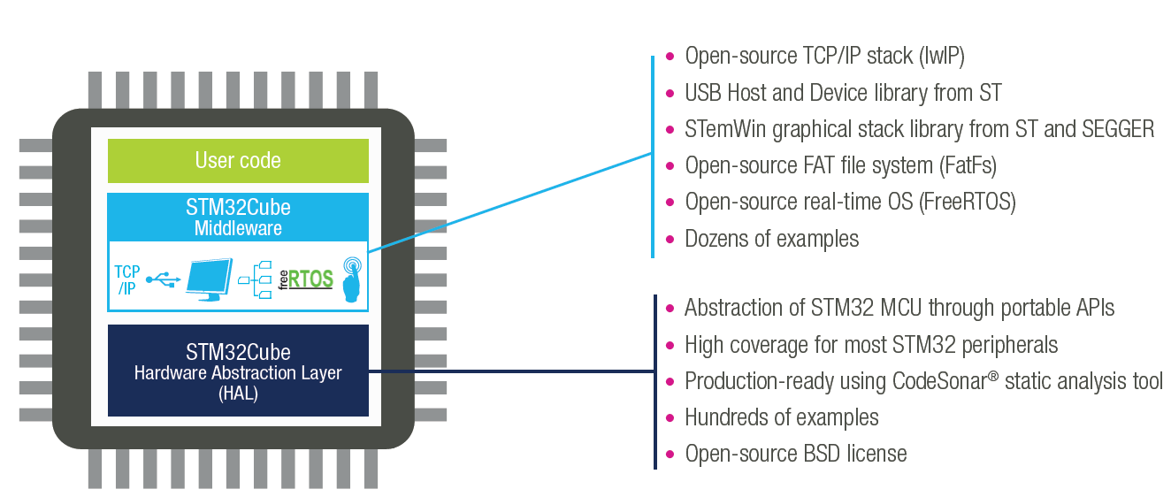
STM32Cube Supporting all STM32 MCUs
Generate your configuration code with the STM32Cube and you can focus on your added-value software !
4 configuration wizards: pinout, clock, peripherals & middleware, power consumption
Portable Hardware Abstraction layer, from series to others
Middleware with RTOS, USB, TCP/IP, File System, Graphics , Touch sensing…
www.st.com/stm32cube

Slide 29
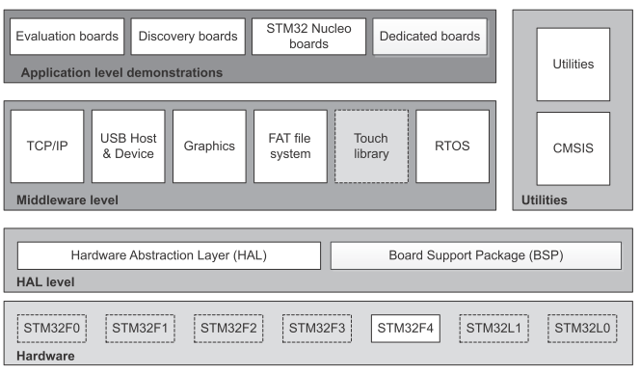
STM32Cube Main Features
STM32Cube gathers together, in a single package, all the generic and highly portable embedded software components required to develop an application on STM32 microcontrollers.
The package includes a low level hardware abstraction layer (HAL) that covers the microcontroller hardware, together with an extensive set of examples running on STMicroelectronics boards.
It also contains a set of middleware components (*) with the corresponding examples. They come with very permissive license terms:
Full USB Host and Device stack supporting many classes.
Host Classes: HID, MSC, CDC, Audio, MTP
Device Classes: HID, MSC, CDC, Audio, DFU
Graphics
STemWin, a professional graphical stack solution available in binary format and based on the emWin solution from ST's partner SEGGER
LibJPEG, an open source implementation on STM32 for JPEG images encoding and decoding.
CMSIS-RTOS implementation with FreeRTOS open source solution
FAT File system based on open source FatFS solution
TCP/IP stack based on open source LwIP solution
SSL/TLS secure layer based on open source PolarSSL
A demonstration implementing all these middleware components is also provided
(*) middleware components availability depends on STM32 Series
Notes:
* All-in one package
*

Slide 30
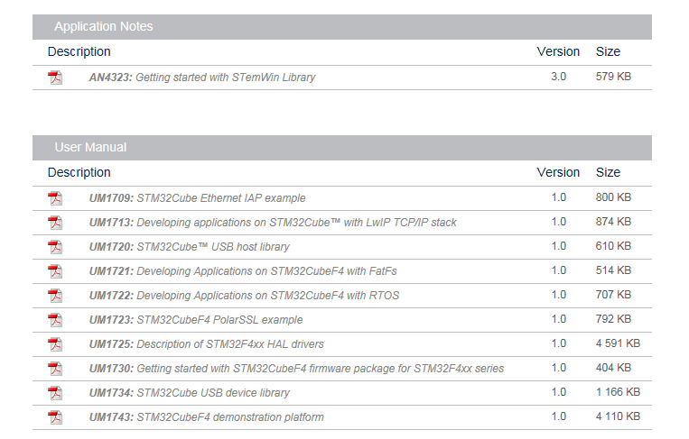
STM32Cube Documentation
Generic doc
Generic doc
Generic doc
Generic doc
Generic doc
Generic doc
Generic doc
Series specific doc
Generic doc
Series specific doc

Slide 31
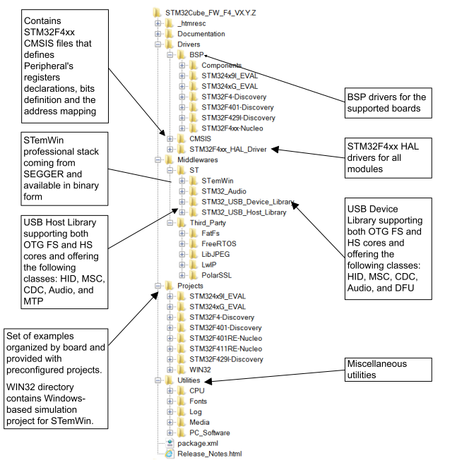
STM32Cube FW Package Organization

Slide 32
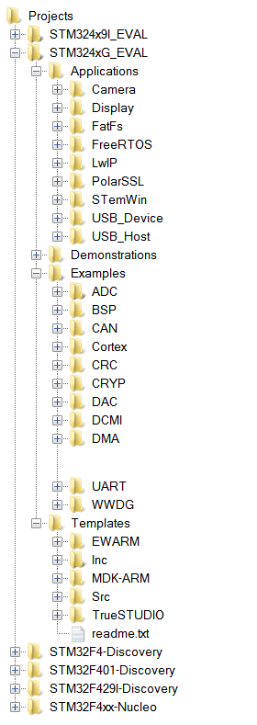
STM32Cube Examples Overview
For each board, a set of examples are provided with preconfigured projects for EWARM, MDK-ARM and TrueSTUDIO toolchains.
The right side figure shows the projects structure for STM324xG-EVAL board, which is identical for other boards.
The examples are classified depending on the STM32Cube level they apply to, and are named as below:
examples in level 0 are called Examples, that uses HAL drivers without any Middleware component
examples in level 1 are called Applications, that provides typical use cases of each Middleware component
examples in level 2 are called Demonstration, that implements all the HAL, BSP and Middleware components
Template project is provided to build quickly any firmware application on a given board.
All examples have the same structure,
\Inc folder that contains all header files
\Src folder for the sources code
\EWARM, \MDK-ARM and \TrueSTUDIO folders contain the preconfigured project for each toolchain.
readme.txt describing the example behavior and needed environment to make it working

Slide 33
Software Development – Toolchains
Many possible Development Toolchains directly supporting STM32
Many open source solutions exist, while Commercial solutions do all have some free options, either time-limited or code size-limited
Commercial solutions:
IAR EWARM
Keil MDK-ARM
Atollic TrueStudio
Rowley CrossWorks
Raisonance Ride
Altium Tasking
…
Free or Open source solutions:
Embest CooCox
SEGGER emIDE
Yagarto
…

Slide 34
STM32 ST-LINK Utility

Slide 35
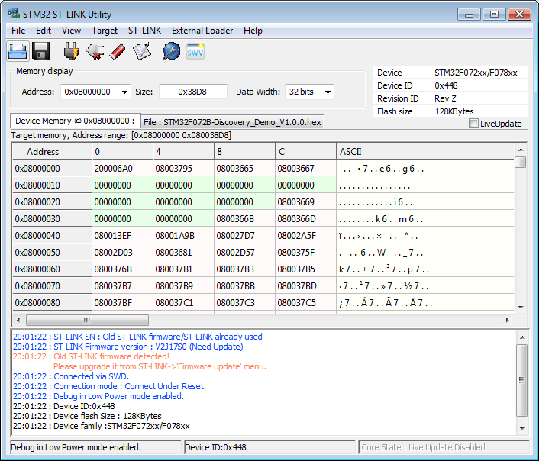
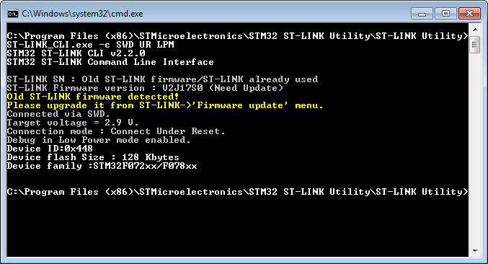
STM32 ST-LINK Utility
Standalone software tool allows in-system programming of STM32 devices
Supports Binary, Hex and Motorola S-Record file formats
Allows programming option bytes
Supports ST-LINK/V2
Command line version available for usage with batch files and small quantity production
ST-LINK_CLI.exe
Supports multiple ST-LINK/V2 connected to same PC
User manual UM0892

Slide 36
ST Visual Programmer

Slide 37
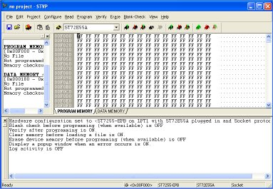
STVP
Free software that supports Motorola S19 and Intel HEX formats
Load, Edit and Save executable and/or data files generated by the Assembler/Linker or C compilers
Erase, Program, View and Verify device Flash memory contents
Project mode to automate all configuration and programming tasks
Programming Toolkit with C/C++ source files for creating a programming application based STVP
STVP supports microcontroller programming via a complete range of hardware development tools and dedicated programmers, including:
ST-LINK in-circuit debugger/programmer for STM8 and STM32

Slide 38
STM32 FLASH LOADER DEMONSTRATOR

Slide 39
FLASH LOADER DEMONSTRATOR
Illustrate the System Memory boot loader capabilities
The Flash loader demonstrator is designed to work with all STMicroelectronics devices that support the system memory boot mode UART protocol

Slide 40
DFUSE

Slide 41
DFUSE
Perform the upgrade operation with some requires, such as:
Product identifier
Vendor identifier
Firmware version
Alternate setting number (Target ID) of the target to be used,
These information makes the upgrade targeted and more secure.
To add this information, a new file format should be used, to be called DFU file format

Slide 42
STMSTUDIO

Slide 43
STMSTUDIO
STM Studio is a non-intrusive tool, preserving the real-time behavior of applications.
STM Studio perfectly complements traditional debugging tools to fine tune applications.
It is well suited for debugging applications which cannot be stopped, such as motor control applications.
Connects to any STM32 via ST-LINK (JTAG or SWD protocols), reads on-the-fly (non intrusive) variables from RAM while application is running

Slide 44
STM32F0 Labs

Slide 45

System Peripherals
1
GPIO & EXTI (1.1)
GPIO lab (1.1.1)
EXTI lab (1.1.2)

Slide 46
Basic communication peripherals
2
UART (2.1)
UART Poll lab (2.1.1)
UART Interrupt lab (2.1.2)
UART DMA lab (2.1.3)
SPI (2.2)
SPI Poll lab (2.2.1)
SPI Interrupt lab (2.2.2)
I2C (2.3)
I2C Interrupt lab (2.3.2)

Slide 47
Timing peripherals
3
TIM (3.1)
TIM Interrupt lab (3.1.1)

Slide 48
Analog peripherals
4
ADC (4.1)
ADC Interrupt lab (4.1.2)

Slide 49
Control peripherals
5
CRC(5.1)
TIM Interrupt lab (5.1.1)

Slide 50
Application
6
IAP
Demonstration of IAP based in AN4657
http://www.st.com/web/en/catalog/tools/FM147/CL1794/SC961/SS1743/LN1920/PF262163?s_searchtype=keyword#

Slide 51
1.1.1 GPIO Lab

Slide 52
Configure GPIO for LED toggling
1.1.1
Objective
Learn how to setup pin and GPIO port in CubeMX
How to Generate Code in CubeMX and use HAL functions
Goal
Configure GPIO pin in CubeMX and Generate Code
Add in to project HAL_Delay function and HAL_GPIO_Toggle function
Verify the correct functionality on toggling LED

Slide 53
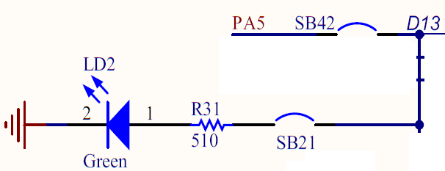
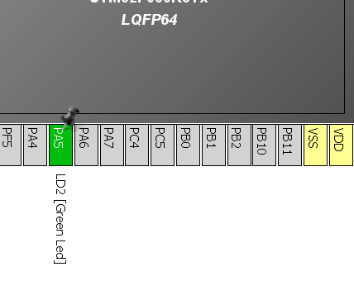
Configure GPIO for LED toggling
1.1.1
Create project in CubeMX
Menu > File > New Project
Select STM32F0 > STM32F030 > LQFP64 > STM32F030R8
Configure LED pin as GPIO_Output

Slide 54
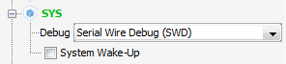
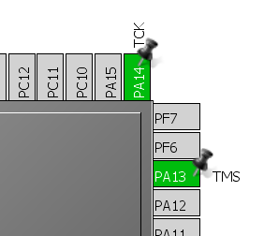
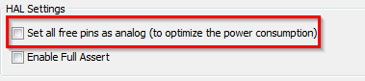
Configure GPIO for LED toggling
1.1.1
For debug purpose is recommended to select debug pins SWD or JTAG
Select can be done in TAB>Pinout>SYS
On discovery is available only SWD option
If SWD/JTAG is not selected and the Set all free pins as analog (MENU>Project>Settings>TAB>Code Generator) is selected, debug is not possible

Slide 55
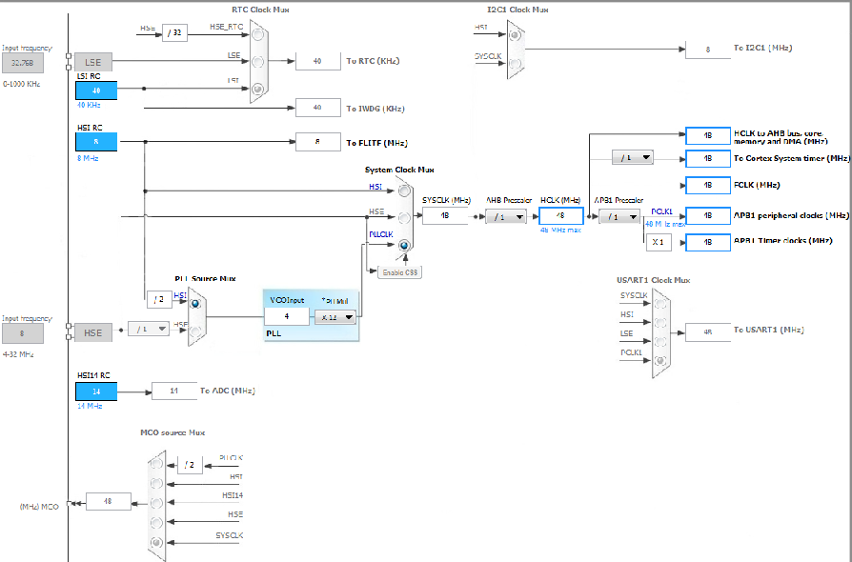
Configure GPIO for LED toggling
1.1.1
Clock Configuration
TAB>Clock Configuration
We can easily setup STM32 clocks

Slide 56
Configure GPIO for LED toggling
1.1.1
The Clock configuration tree is interactive version of tree from RM
RM0360 Chapter 7 Reset and clock control Page 80

Slide 57
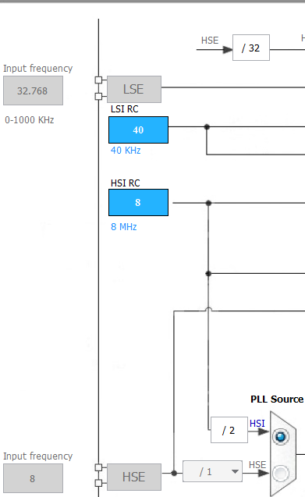
Configure GPIO for LED toggling
1.1.1
Clock Configuration overview 1
Clock sources
Internal oscillators
Internal oscillators

Slide 58
Configure GPIO for LED toggling
1.1.1
Clock Configuration overview 3
Clock sources
Internal oscillators
External clock sources
External clock sources

Slide 59
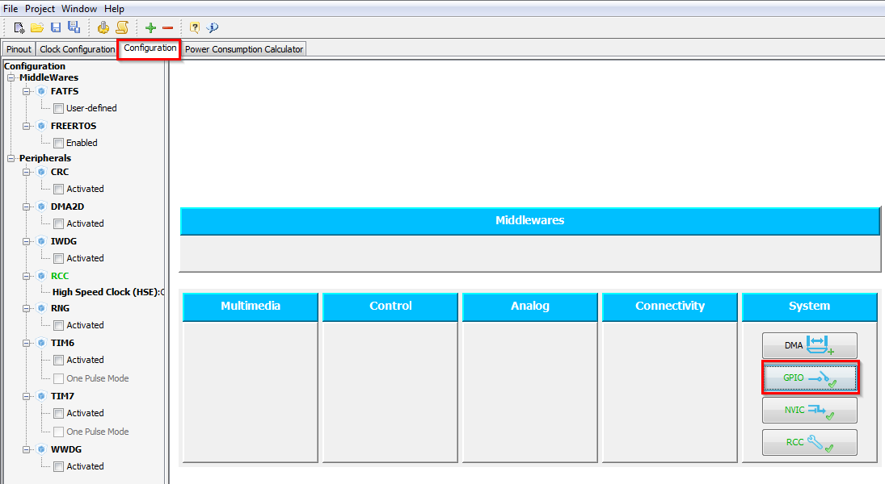
Configure GPIO for LED toggling
1.1.1
GPIO Configuration
TAB>Configuration>System>GPIO

Slide 60
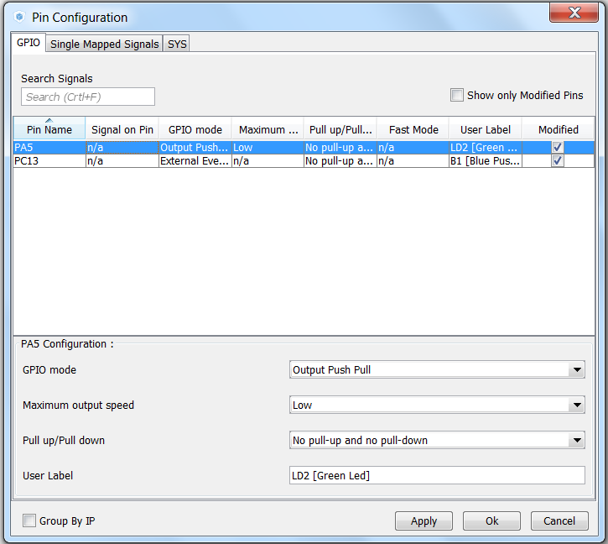
Configure GPIO for LED toggling
1.1.1
GPIO(Pin) Configuration
Select Push Pull mode
No pull-up and pull-down
Output speed to HIGH Is important for faster peripheries like SPI, USART
Button OK

Slide 61
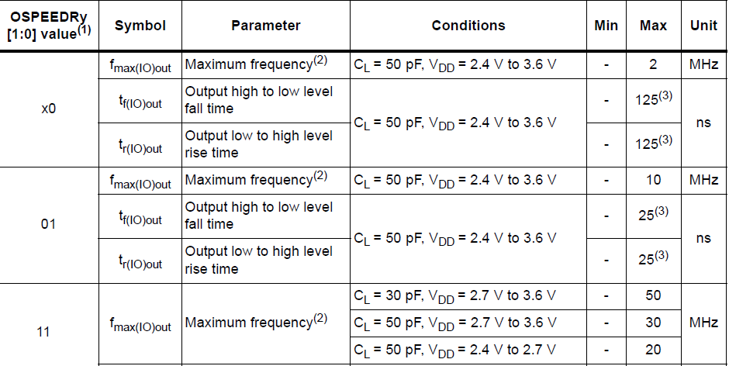
Configure GPIO for LED toggling
1.1.1
GPIO(Pin) output speed configuration
Change the rising and falling edge when pin change state from high to low or low to high
Higher GPIO speed increase EMI noise from STM32 and increase STM32 consumption
It is good to adapt GPIO speed with periphery speed. Ex.: Toggling GPIO on 1Hz is LOW optimal settings, but SPI on 45MHz the HIGH must be set
GPIO output LOW speed
GPIO output MEDIUM speed
LOW
LOW
HIGH
HIGH
GPIO output HIGH speed
LOW
HIGH

Slide 62
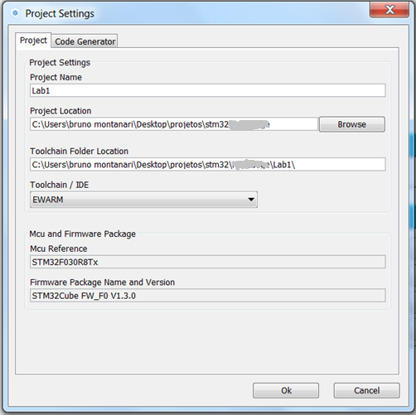
Configure GPIO for LED toggling
1.1.1
Now we set the project details for generation
Menu > Project > Project Settings
Set the project name
Project location
Type of toolchain
Now we can Generate Code
Menu > Project > Generate Code

Slide 63
Configure GPIO for LED toggling
1.1.1
Now we open the project in our IDE
The functions we want to put into main.c
Between /* USER CODE BEGIN 3 */ and /* USER CODE END 3 */ tags
Into infinite loop while(1){ }
For toggling we need to use this functions
HAL_HAL_Delay which create specific delay
HAL_GPIO_WritePin or HAL_GPIO_TogglePin

Slide 64
Configure GPIO for LED toggling
1.1.1
Now we open the project in our IDE
The functions we want to put into main.c
Between /* USER CODE BEGIN 3 */ and /* USER CODE END 3 */ tags
Into infinite loop while(1){ }
For toggling we need to use this functions
HAL_HAL_Delay which create specific delay
HAL_GPIO_WritePin or HAL_GPIO_TogglePin
/* USER CODE BEGIN 3 */
/* Infinite loop */
while (1)
{
HAL_GPIO_WritePin(GPIOA, GPIO_PIN_5, GPIO_PIN_SET);
HAL_Delay(500);
HAL_GPIO_WritePin(GPIOA, GPIO_PIN_5, GPIO_PIN_RESET);
HAL_Delay(500);
}
/* USER CODE END 3 */

Slide 65
1.1.2 EXTI lab

Slide 66
Configure EXTI to turn on LED
1.1.2
Objective
Learn how to setup input pin with EXTI in CubeMX
How to Generate Code in CubeMX and use HAL functions
Goal
Configure GPIO and EXTI pin in CubeMX and Generate Code
Add into project Callback function and function which turn on led
Verify the correct functionality by pressing button which turns on LED

Slide 67
Configure EXTI to turn on LED
1.1.2
Create project in CubeMX
Menu > File > New Project
Select STM32F0 > STM32F030 > LQFP64 > STM32F030R8
Configure LED pin as GPIO_Output

Slide 68
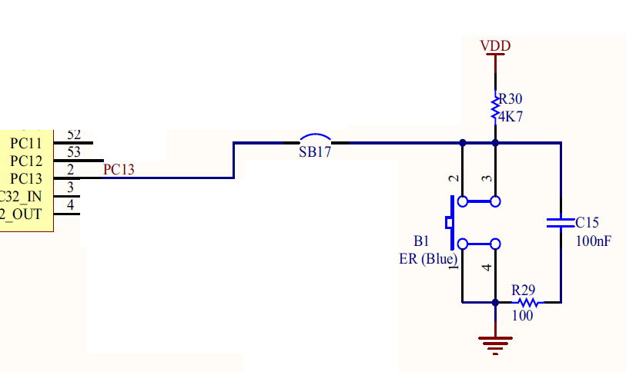
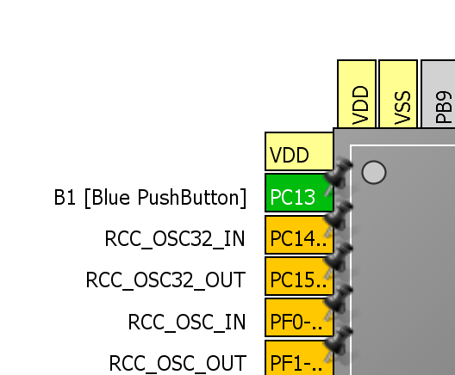
Configure EXTI to turn on LED
1.1.2
Configure Button pin as GPIO_EXTIX

Slide 69
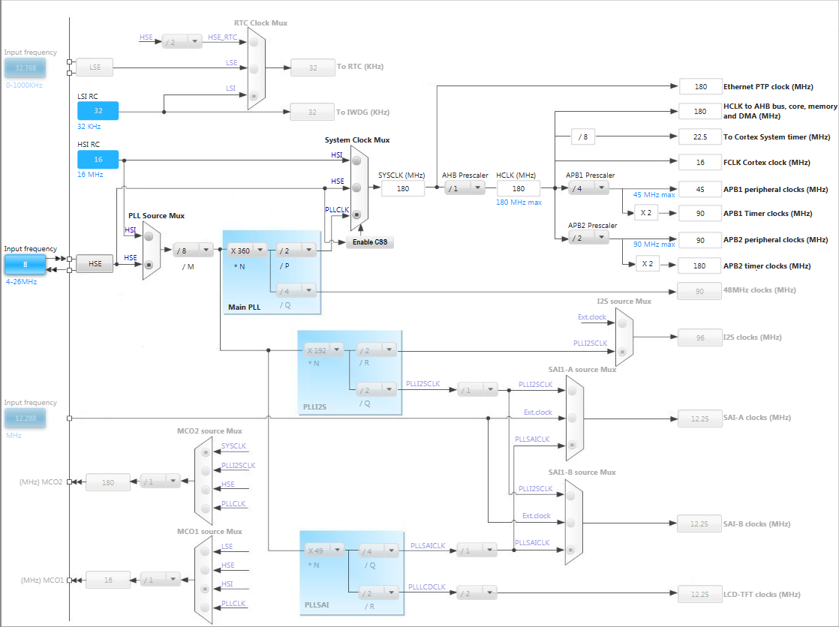
Configure EXTI to turn on LED
1.1.2
In order to run on maximum frequency, setup clock system
Details in lab 0

Slide 70
Configure EXTI to turn on LED
1.1.2
GPIO Configuration
TAB>Configuration>System>GPIO

Slide 71
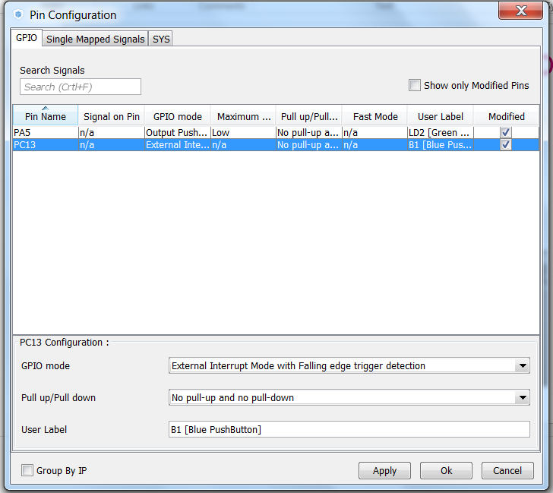
Configure EXTI to turn on LED
1.1.2
GPIO(Pin) Configuration
Select External Interrupt Mode with Faling edge trigger detection
No pull-up or pull-down
Button OK

Slide 72
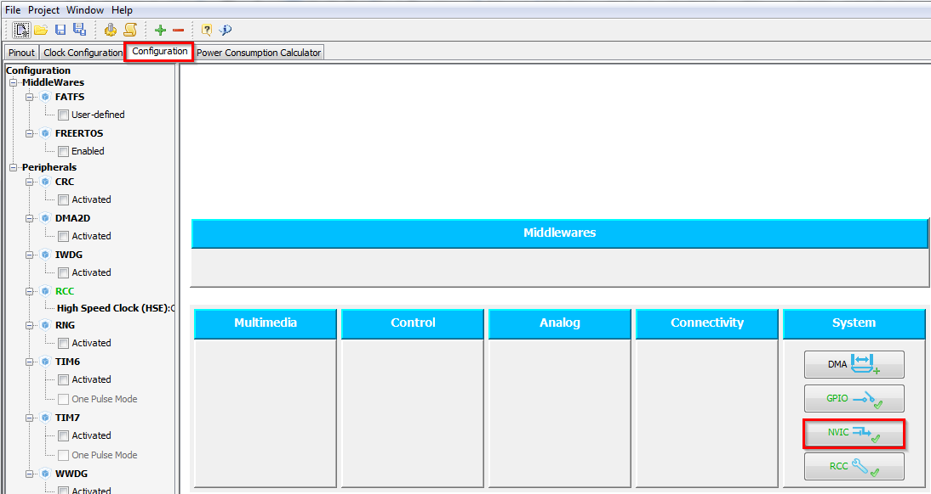
Configure EXTI to turn on LED
1.1.2
NVIC Configuration
We need to enable interrupts for EXTI
TAB>Configuration>System>NVIC

Slide 73
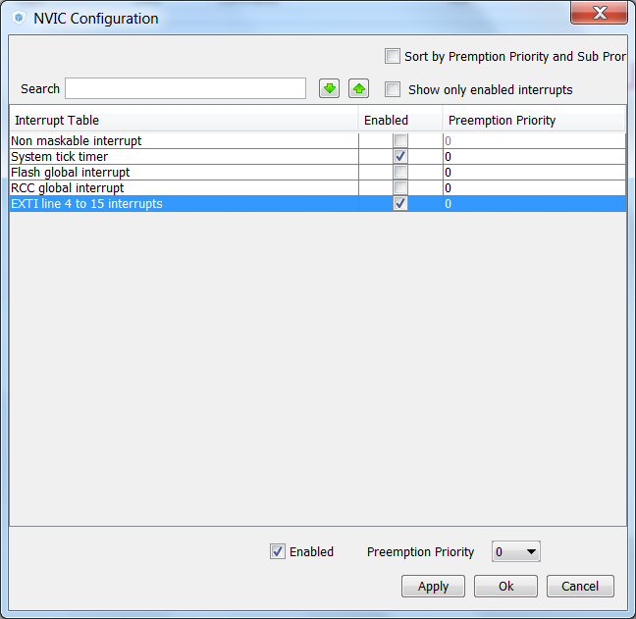
Configure EXTI to turn on LED
1.1.2
NVIC Configuration
Enable interrupt for EXTI Line4_15
Button OK

Slide 74
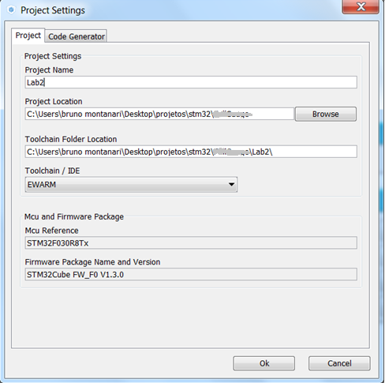
Configure EXTI to turn on LED
1.1.2
Now we set the project details for generation
Menu > Project > Project Settings
Set the project name
Project location
Type of toolchain
Now we can Generate Code
Menu > Project > Generate Code

Slide 75
Configure EXTI to turn on LED
1.1.2
HAL Library work flow 1
Peripheral Initializations
including peripheral interrupt NVIC initializations
Generated by CubeMX
Configure the GPIO to generate interrupt on rising or falling edge
HAL_EXTI4_15_IRQHandler
EXTI4_15_IRQHandler
Edge detection callback
HAL_GPIO_EXTI_Callback

Slide 76
Configure EXTI to turn on LED
1.1.2
HAL Library work flow 2
Peripheral Initializations
including peripheral interrupt NVIC initializations
MX_GPIO_Init
inside main.c
Configure the GPIO to generate interrupt on rising or falling edge
HAL_EXTI4_15_IRQHandler
EXTI4_15_IRQHandler
Edge detection callback
HAL_GPIO_EXTI_Callback

Slide 77
Configure EXTI to turn on LED
1.1.2
HAL Library working flow 3
Peripheral Initializations
including peripheral interrupt NVIC initializations
inside stm32f0xx_it.c
Configure the GPIO to generate interrupt on rising or falling edge
HAL_EXTI4_15_IRQHandler
EXTI4_15_IRQHandler
Edge detection callback
HAL_GPIO_EXTI_Callback

Slide 78
Configure EXTI to turn on LED
1.1.2
HAL Library work flow 4
Peripheral Initializations
including peripheral interrupt NVIC initializations
Configure the GPIO to generate interrupt on rising or falling edge
HAL_EXTI4_15_IRQHandler
EXTI4_15_IRQHandler
Edge detection callback
HAL_GPIO_EXTI_Callback
User must define Callback it is declared by default as empty weak

Slide 79
Configure EXTI to turn on LED
1.1.2
HAL Library work flow 5
Peripheral Initializations
including peripheral interrupt NVIC initializations
Configure the GPIO to generate interrupt on rising or falling edge
HAL_EXTI4_15_IRQHandler
EXTI4_15_IRQHandler
Edge detection callback
HAL_GPIO_EXTI_Callback
Usually in main.c between /* USER CODE BEGIN */
tags

Slide 80
Configure EXTI to turn on LED
1.1.2
HAL Library work flow summary
3. create edge
1. init NVIC
Peripheral Initializations
including peripheral interrupt NVIC initializations
2. init GPIO
Configure the GPIO to generate interrupt on rising or falling edge
5. HAL EXTI interrupt handler
4. EXTI interrupt handler
HAL_EXTI4_15_IRQHandler
EXTI4_15_IRQHandler
Edge detection callback
HAL_GPIO_EXTI_Callback
HAL files clearing flags, check errors, …
6. HAL EXTI callback

Slide 81
Configure EXTI to turn on LED
1.1.2
Now we open the project in our IDE
The functions we want to put into main.c
Between /* USER CODE BEGIN 4 */ and /* USER CODE END 4 */ tags
We create function which will handle the EXTI interrupts
The HAL callback function for EXTI
void HAL_GPIO_EXTI_Callback(uint16_t GPIO_Pin)
For LED turn on we need to use this functions
HAL_GPIO_WritePin

Slide 82
Configure EXTI to turn on LED
1.1.2
Now we open the project in our IDE
The functions we want to put into main.c
Between /* USER CODE BEGIN 4 */ and /* USER CODE END 4 */ tags
We create function which will handle the EXTI interrupts
The HAL callback function for EXTI
void HAL_GPIO_EXTI_Callback(uint16_t GPIO_Pin)
For LED turn on we need to use this functions
HAL_GPIO_WritePin
/* USER CODE BEGIN 4 */
void HAL_GPIO_EXTI_Callback(uint16_t GPIO_Pin)
{
if(GPIO_Pin == GPIO_PIN_13) {
HAL_GPIO_WritePin(GPIOA, GPIO_PIN_5, GPIO_PIN_SET);
} else {
__NOP();
}
}
/* USER CODE END 4 */

Slide 83
1.3.1 Data transfer over DMA lab

Slide 84
Use DMA in M2M transfer
1.3.1
Objective
Learn how to setup DMA transfer in CubeMX
Create simple DMA memory to memory transfer from RAM to RAM
Goal
Use CubeMX and Generate Code with DMA
Learn how to setup the DMA in HAL
Verify the correct functionality by comparing transferred buffers

Slide 85

Use DMA in M2M transfer
1.3.1
Create project in CubeMX
Menu > File > New Project
Select STM32F0 > STM32F030 > LQF64 > STM32F030R8
For DMA we don’t need to configure any pins

Slide 86
Use DMA in M2M transfer
1.3.1
In order to run on maximum frequency, setup clock system
Details in lab 0

Slide 87

Use DMA in M2M transfer
1.3.1
DMA configuration
TAB>Configuration
System>DMA
TAB>DMA1
Button ADD
1. TAB > Configuration
2. System DMA
3. TAB>DMA 1
4. Add DMA channel

Slide 88

Use DMA in M2M transfer
1.3.1
DMA configuration
Select MEMTOMEM DMA request
Normal mode
Increment source and destination address
Byte data width
Button OK
1. MEMTOMEM
3. Increment addresses
2. Normal mode
4. Byte
5. OK

Slide 89

Use DMA in M2M transfer
1.3.1
Now we set the project details for generation
Menu > Project > Project Settings
Set the project name
Project location
Type of toolchain
Now we can Generate Code
Menu > Project > Generate Code

Slide 90
Use DMA in M2M transfer
1.3.1
Start process DMA (same for TIM, ADC)
Non blocking start process
The end of the process must be checked by polling
1. init DMA
Peripheral Initializations
2. Start DMA
Start Process
(HAL_DMA_Start)
3. DMA transfer data
Poll for process complete
(HAL_DMA_PollForTransfer)
4. Check if transfer is complete

Slide 91
Use DMA in M2M transfer
1.3.1
Return values
Most of CubeMX functions have return values, which indicate, if operation was successful, timeout occurs of function end with error
Is recommended handle this return values to be sure that program working as expected
Ex: Poll for process complete
(HAL_DMA_PollForTransfer)
HAL_OK
HAL_ERROR
HAL_BUSY
DMA transfer was successfully finished and data was transferred to destination without error

Slide 92
Use DMA in M2M transfer
1.3.1
Return values
Most of CubeMX functions have return values, which indicate, if operation was successful, timeout occurs of function end with error
Is recommended handle this return values to be sure that program working as expected
Ex: Poll for process complete
(HAL_DMA_PollForTransfer)
HAL_OK
HAL_ERROR
HAL_BUSY
Error occurs during DMA transfer you use HAL_DMA_GetError for details what happened

Slide 93
Use DMA in M2M transfer
1.3.1
Return values
Most of CubeMX functions have return values, which indicate, if operation was successful, timeout occurs of function end with error
Is recommended handle this return values to be sure that program working as expected
Ex: Poll for process complete
(HAL_DMA_PollForTransfer)
HAL_OK
HAL_ERROR
HAL_BUSY
DMA transfer in progress, user can only abort the transfer

Slide 94
Use DMA in M2M transfer
1.3.1
Now we open the project in our IDE
The functions we want to put into main.c
Between /* USER CODE BEGIN 2 */ and /* USER CODE END 2 */ tags
HAL functions for DMA
HAL_DMA_Start(DMA_HandleTypeDef *hdma, uint32_t SrcAddress, uint32_t DstAddress, uint32_t DataLength)
HAL_DMA_PollForTransfer(DMA_HandleTypeDef *hdma, uint32_t CompleteLevel, uint32_t Timeout)

Slide 95
Use DMA in M2M transfer
1.3.1
We create two buffers
One with source data
Second as destination buffer
/* USER CODE BEGIN 0 */
uint8_t Buffer_Src[]={0,1,2,3,4,5,6,7,8,9};
uint8_t Buffer_Dest[10];
/* USER CODE END 0 */

Slide 96
Use DMA in M2M transfer
1.3.1
HAL_DMA_Start start the M2M data transfer
HAL_DMA_PollForTransfer check if the transfer ends successfully
Remember to extern the hdma_memtomem_dma1_channel1 structure
/* USER CODE BEGIN 2 */
HAL_DMA_Start(& hdma_memtomem_dma1_channel1, (uint32_t) (Buffer_Src), (uint32_t) (Buffer_Dest), 10);
while(HAL_DMA_PollForTransfer(&hdma_memtomem_dma1_channel1, HAL_DMA_FULL_TRANSFER, 100) != HAL_OK)
{
__NOP();
}
/* USER CODE END 2 */

Slide 97
1.3.2 Data transfer over DMA with interrupt lab

Slide 98
Use DMA M2M with interrupt
1.3.2
Objective
Learn how to setup DMA transfer with interrupt in CubeMX
Create simple DMA memory to memory transfer from RAM to RAM
Goal
Use CubeMX and Generate Code with DMA
Learn how to setup the DMA in HAL
Verify the correct functionality by comparing transferred buffers

Slide 99
Use DMA M2M with interrupt
1.3.2
Create project in CubeMX
Menu > File > New Project
Select STM32F0 > STM32F030 > LQF64 > STM32F030R8
For DMA we don’t need to configure any pins

Slide 100
Use DMA M2M with interrupt
1.3.2
In order to run on maximum frequency, setup clock system
Details in lab 0

Slide 101
Use DMA M2M with interrupt
1.3.2
DMA configuration
TAB>Configuration
System>DMA
TAB>DMA1
Button ADD
1. TAB > Configuration
2. System DMA
3. TAB>DMA 1
4. Add DMA channel

Slide 102
Use DMA M2M with interrupt
1.3.2
DMA configuration
Select MEMTOMEM DMA request
Normal mode
Increment source and destination address
Byte data width
Button OK
1. MEMTOMEM
3. Increment addresses
2. Normal mode
4. Byte
5. OK

Slide 103

Use DMA M2M with interrupt
1.3.2
DMA configuration
System > NVIC
Enable DMA1 Stream interrupt
Button OK
2. System > NVIC
3. Enable DMA1 interrupts
4. OK

Slide 104

Use DMA M2M with interrupt
1.3.2
Now we set the project details for generation
Menu > Project > Project Settings
Set the project name
Project location
Type of toolchain
Now we can Generate Code
Menu > Project > Generate Code

Slide 105
Use DMA M2M with interrupt
1.3.2
HAL Library DMA with IT flow
DMA Initializations
including peripheral interrupt NVIC initializations
Start process with interrupt generation at end of process
HAL_DMA_Start_IT
HAL_OK
HAL_ERROR
HAL_DMA_IRQHandler
DMA1_Channel1_IRQHandler
HAL_BUSY
end of process callback
DMA_XferCpltCallback
process Error callback
DMA_XferErrorCallback

Slide 106
Use DMA M2M with interrupt
1.3.2
HAL Library DMA with IT flow
DMA Initializations
including peripheral interrupt NVIC initializations
Generated by CubeMX
Start process with interrupt generation at end of process
HAL_DMA_Start_IT
HAL_OK
HAL_ERROR
HAL_DMA_IRQHandler
DMA1_Channel1_IRQHandler
HAL_BUSY
end of process callback
DMA_XferCpltCallback
process Error callback
DMA_XferErrorCallback

Slide 107
Use DMA M2M with interrupt
1.3.2
HAL Library DMA with IT flow
DMA Initializations
including peripheral interrupt NVIC initializations
Start process with interrupt generation at end of process
HAL_DMA_Start_IT
HAL_OK
HAL_ERROR
HAL_DMA_IRQHandler
DMA1_Channel1_IRQHandler
HAL_BUSY
end of process callback
DMA_XferCpltCallback
Defined by user
process Error callback
DMA_XferErrorCallback

Slide 108
Use DMA M2M with interrupt
1.3.2
HAL Library DMA with IT flow
DMA Initializations
including peripheral interrupt NVIC initializations
Generated in main.c
Start process with interrupt generation at end of process
HAL_DMA_Start_IT
HAL_OK
HAL_ERROR
HAL_DMA_IRQHandler
DMA1_Channel1_IRQHandler
HAL_BUSY
end of process callback
DMA_XferCpltCallback
process Error callback
DMA_XferErrorCallback

Slide 109
Use DMA M2M with interrupt
1.3.2
HAL Library DMA with IT flow
DMA Initializations
including peripheral interrupt NVIC initializations
Start process with interrupt generation at end of process
HAL_DMA_Start_IT
HAL_OK
HAL_ERROR
HAL_DMA_IRQHandler
DMA1_Channel1_IRQHandler
HAL_BUSY
end of process callback
DMA_XferCpltCallback
We recommend to use it in main.c
process Error callback
DMA_XferErrorCallback

Slide 110
Use DMA M2M with interrupt
1.3.2
HAL Library DMA with IT flow
DMA Initializations
including peripheral interrupt NVIC initializations
Start process with interrupt generation at end of process
HAL_DMA_Start_IT
HAL_OK
HAL_ERROR
HAL_DMA_IRQHandler
DMA1_Channel1_IRQHandler
HAL_BUSY
end of process callback
DMA_XferCpltCallback
User defined functions. The user must define functions by himself and put function names into DMA structure
process Error callback
DMA_XferErrorCallback

Slide 111
Use DMA M2M with interrupt
1.3.2
HAL Library DMA with IT flow
DMA Initializations
including peripheral interrupt NVIC initializations
Start process with interrupt generation at end of process
HAL_DMA_Start_IT
HAL_OK
HAL_ERROR
HAL_DMA_IRQHandler
DMA1_Channel1_IRQHandler
HAL_BUSY
end of process callback
DMA_XferCpltCallback
Generated in stm32f0xx_it.c
process Error callback
DMA_XferErrorCallback

Slide 112
Use DMA M2M with interrupt
1.3.2
HAL Library DMA with IT flow
DMA Initializations
including peripheral interrupt NVIC initializations
Start process with interrupt generation at end of process
HAL_DMA_Start_IT
HAL_OK
HAL_ERROR
HAL_DMA_IRQHandler
DMA1_Channel1_IRQHandler
HAL_BUSY
end of process callback
DMA_XferCpltCallback
Defined in stm32f0xx_hal_dma.c
process Error callback
DMA_XferErrorCallback

Slide 113
Use DMA M2M with interrupt
1.3.2
HAL Library DMA with IT flow
DMA Initializations
including peripheral interrupt NVIC initializations
Start DMA buffer transfer
Not blocking function program can continue
Start process with interrupt generation at end of process
HAL_DMA_Start_IT
HAL_OK
HAL_ERROR
HAL_DMA_IRQHandler
DMA1_Channel1_IRQHandler
HAL_BUSY
end of process callback
DMA_XferCpltCallback
process Error callback
DMA_XferErrorCallback

Slide 114
Use DMA M2M with interrupt
1.3.2
HAL Library DMA with IT flow
Interrupt indicate DMA process is half/complete or error was detected
DMA Initializations
including peripheral interrupt NVIC initializations
Start process with interrupt generation at end of process
HAL_DMA_Start_IT
HAL_OK
HAL_ERROR
HAL_DMA_IRQHandler
DMA1_Channel1_IRQHandler
HAL_BUSY
end of process callback
DMA_XferCpltCallback
process Error callback
DMA_XferErrorCallback

Slide 115
Use DMA M2M with interrupt
1.3.2
HAL Library DMA with IT flow
DMA Initializations
including peripheral interrupt NVIC initializations
Process interrupt information
Start process with interrupt generation at end of process
HAL_DMA_Start_IT
HAL_OK
HAL_ERROR
HAL_DMA_IRQHandler
DMA1_Channel1_IRQHandler
HAL_BUSY
end of process callback
DMA_XferCpltCallback
process Error callback
DMA_XferErrorCallback

Slide 116
Use DMA M2M with interrupt
1.3.2
HAL Library DMA with IT flow
DMA Initializations
including peripheral interrupt NVIC initializations
Start process with interrupt generation at end of process
HAL_DMA_Start_IT
HAL_OK
HAL_ERROR
HAL_DMA_IRQHandler
DMA1_Channel1_IRQHandler
HAL_BUSY
end of process callback
DMA_XferCpltCallback
Data correctly transferred
Complete callback function
process Error callback
DMA_XferErrorCallback

Slide 117
Use DMA M2M with interrupt
1.3.2
HAL Library DMA with IT flow
DMA Initializations
including peripheral interrupt NVIC initializations
Start process with interrupt generation at end of process
HAL_DMA_Start_IT
HAL_OK
HAL_ERROR
HAL_DMA_IRQHandler
DMA1_Channel1_IRQHandler
HAL_BUSY
end of process callback
DMA_XferCpltCallback
Error was detected
Error callback function
process Error callback
DMA_XferErrorCallback

Slide 118
Use DMA M2M with interrupt
1.3.2
HAL Library DMA with IT flow
1. DMA init
DMA Initializations
including peripheral interrupt NVIC initializations
Start process with interrupt generation at end of process
HAL_DMA_Start_IT
2. DMA transfer start
HAL_OK
HAL_ERROR
HAL_DMA_IRQHandler
DMA1_Channel1_IRQHandler
HAL_BUSY
4. HAL DMA management
3. DMA transfer complete or error
end of process callback
DMA_XferCpltCallback
5. DMA transfer was correct
process Error callback
DMA_XferErrorCallback
5. Error in DMA transfer

Slide 119
Use DMA M2M with interrupt
1.3.2
Now we open the project in our IDE
The functions we want to put into main.c
Between /* USER CODE BEGIN 2 */ and /* USER CODE END 2 */ tags
DMA callback function
We need to add the name of callback function into DMA structure
HAL functions for DMA
HAL_DMA_Start_IT(DMA_HandleTypeDef *hdma, uint32_t SrcAddress, uint32_t DstAddress, uint32_t DataLength)

Slide 120
Use DMA M2M with interrupt
1.3.2
We create two buffers
One with source data
Second as destination buffer
/* USER CODE BEGIN 0 */
uint8_t Buffer_Src[]={0,1,2,3,4,5,6,7,8,9};
uint8_t Buffer_Dest[10];
/* USER CODE END 0 */

Slide 121
Use DMA M2M with interrupt
1.3.2
DMA callback creation function prototype
DMA complete callback with nop where we can put breakpoint
/* USER CODE BEGIN 0 */
uint8_t Buffer_Src[]={0,1,2,3,4,5,6,7,8,9};
uint8_t Buffer_Dest[10];
void XferCpltCallback(DMA_HandleTypeDef *hdma);
/* USER CODE END 0 */
/* USER CODE BEGIN 4 */
void XferCpltCallback(DMA_HandleTypeDef *hdma)
{
__NOP();//we reach this only if DMA transfer was correct
}
/* USER CODE END 4 */

Slide 122
Use DMA M2M with interrupt
1.3.2
DMA Start
Before we start the DMA with interrupt we need to set the callback into DMA structure
Then is possible use the HAL_DMA_Start_IT to begin DMA transfer
/* USER CODE BEGIN 2 */
hdma_memtomem_dma1_channel1.XferCpltCallback=&XferCpltCallback;
HAL_DMA_Start_IT(&hdma_memtomem_dma1_channel1,(uint32_t)Buffer_Src,(uint32_t)Buffer_Dest,10);
/* USER CODE END 2 */

Slide 123
2.1.1 UART Poll lab

Slide 124
Simple UART communication
2.1.1
Objective
Learn how to setup UART in CubeMX
How to Generate Code in CubeMX and use HAL functions
Work in pairs, one will create transmitter and second receiver
Goal
Configure UART in CubeMX and Generate Code
Learn how to send and receive data over UART without interrupts
Verify the correct functionality

Slide 125
Simple UART communication
2.1.1
Create project in CubeMX
Menu > File > New Project
Select STM32F0 > STM32F030 > LQFP64 > STM32F030R8
Pin selection
We are looking for free pins where is possible to create wire loopback connection

Slide 126


Simple UART communication
2.1.1
Create project in CubeMX
Menu > File > New Project
Select STM32F0 > STM32F030 > LQFP64 > STM32F030R8
CubeMX UART selection
Select USART2 in asynchronous mode
Select PA2 and PA3 for USART2 if weren't selected

Slide 127
Simple UART communication
2.1.1
In order to run on maximum frequency, setup clock system
Details in lab 0

Slide 128

Simple UART communication
2.1.1
CubeMX UART configuration
Tab>Configuration>Connectivity>USART2

Slide 129

Simple UART communication
2.1.1
CubeMX USART configuration check:
BaudRate
World length
Parity
Stop bits
Data direction
Oversampling

Slide 130

Simple UART communication
2.1.1
CubeMX USART GPIO configuration check:
On high baud rate set the GPIO speed to HIGH
Set the HIGH output speed Button OK

Slide 131

Simple UART communication
2.1.1
Now we set the project details for generation
Menu > Project > Project Settings
Set the project name
Project location
Type of toolchain
Now we can Generate Code
Menu > Project > Generate Code

Slide 132
Simple UART communication
2.1.1
HAL Library init flow
CubeMX UART init start in main.c file
Peripheral Initializations
MX_USART2_UART_Init();
Init UART2 structure
HAL_UART_Init(&huart2);
HAL_UART_MspInit callback
Init GPIO and NVIC for UART

Slide 133
Simple UART communication
2.1.1
HAL Library init flow
1. We need init UART2
Peripheral Initializations
MX_USART2_UART_Init();
Init UART2 structure
HAL_UART_Init(&huart2);
HAL_UART_MspInit callback
Init GPIO and NVIC for UART

Slide 134
Simple UART communication
2.1.1
HAL Library init flow
1. We need init UART2
Peripheral Initializations
CubeMX create for us function which handle UART initialization
MX_USART2_UART_Init();
Init UART2 structure
HAL_UART_Init(&huart2);
HAL_UART_MspInit callback
Init GPIO and NVIC for UART

Slide 135
Simple UART communication
2.1.1
HAL Library init flow
1. We need init UART2
Peripheral Initializations
MX_USART2_UART_Init();
2. Call UART2 init function
Init UART2 structure
HAL_UART_Init(&huart2);
HAL_UART_MspInit callback
Init GPIO and NVIC for UART

Slide 136
Simple UART communication
2.1.1
HAL Library init flow
1. We need init UART2
Peripheral Initializations
MX_USART2_UART_Init();
2. Call UART2 init function
CubeMX fill the UART structure with parameters which we choose in Configuration window
Init UART2 structure
HAL_UART_Init(&huart2);
HAL_UART_MspInit callback
Init GPIO and NVIC for UART

Slide 137
Simple UART communication
2.1.1
HAL Library init flow
1. We need init UART2
Peripheral Initializations
MX_USART2_UART_Init();
2. Call UART2 init function
Init UART2 structure
3. Store UART2 configuration into structure
HAL_UART_Init(&huart2);
HAL_UART_MspInit callback
Init GPIO and NVIC for UART

Slide 138
Simple UART communication
2.1.1
HAL Library init flow
1. We need init UART2
Peripheral Initializations
MX_USART2_UART_Init();
2. Call UART2 init function
3. Store UART1 configuration into structure
Init UART2 structure
3. Store UART2 configuration into structure
Function wrote parameters from structure into UART1 registers
HAL_UART_Init(&huart2);
HAL_UART_MspInit callback
Init GPIO and NVIC for UART

Slide 139
Simple UART communication
2.1.1
HAL Library init flow
1. We need init UART2
Peripheral Initializations
MX_USART2_UART_Init();
2. Call UART2 init function
3. Store UART1 configuration into structure
Init UART2 structure
3. Store UART2 configuration into structure
HAL_UART_Init(&huart2);
4. Write to UART2 registers
Optional callback from HAL_UART_Init function, be default empty weak function
HAL_UART_MspInit callback
Init GPIO and NVIC for UART

Slide 140
Simple UART communication
2.1.1
HAL Library init flow
1. We need init UART2
Peripheral Initializations
MX_USART2_UART_Init();
2. Call UART2 init function
3. Store UART1 configuration into structure
Init UART2 structure
3. Store UART2 configuration into structure
HAL_UART_Init(&huart2);
4. Write to UART2 registers
CubeMX configure here UART1 GPIOs and enable UART2 clock system
HAL_UART_MspInit callback
Init GPIO and NVIC for UART

Slide 141
Simple UART communication
2.1.1
HAL Library init flow
1. We need init UART2
Peripheral Initializations
MX_USART2_UART_Init();
2. Call UART2 init function
Init UART2 structure
3. Store UART2 configuration into structure
HAL_UART_Init(&huart2);
4. Write to UART2 registers
HAL_UART_MspInit callback
5. UART2 init callback
Init GPIO and NVIC for UART
CubeMX configure here UART1 GPIOs and enable UART2 clock system and NVIC

Slide 142
Simple UART communication
2.1.1
HAL Library init flow
1. We need init UART2
Peripheral Initializations
MX_USART2_UART_Init();
2. Call UART2 init function
3. Store UART1 configuration into structure
Init UART2 structure
3. Store UART2 configuration into structure
HAL_UART_Init(&huart2);
4. Write to UART2 registers
HAL_UART_MspInit callback
5. UART2 init callback
Init GPIO and NVIC for UART
6. UART2 GPIOS, NVIC and RCC init

Slide 143
Simple UART communication
2.1.1
HAL Library init flow
1. We need init UART2
Peripheral Initializations
2. Call UART1 init function
MX_USART2_UART_Init();
2. Call UART2 init function
Init UART2 structure
3. Store UART2 configuration into structure
HAL_UART_Init(&huart2);
4. Write to UART2 registers
HAL_UART_MspInit callback
5. UART2 init callback
Init GPIO and NVIC for UART
6. UART2 GPIOS, NVIC and RCC init
7. Next periph init or user code

Slide 144
Simple UART communication
2.1.1
HAL Library transmit flow
Peripheral Initializations
Generated by CubeMX
Polling process
HAL_UART_Transmit
Function blocks
Polling with timeout
HAL_TIMEOUT
HAL_OK
HAL_ERROR
HAL_BUSY

Slide 145
Simple UART communication
2.1.1
HAL Library transmit flow
Created by user
Peripheral Initializations
Polling process
HAL_UART_Transmit
Function blocks
Polling with timeout
HAL_TIMEOUT
HAL_OK
HAL_ERROR
HAL_BUSY

Slide 146
Simple UART communication
2.1.1
HAL Library receive flow
Peripheral Initializations
Generated by CubeMX
Polling process
HAL_UART_Receive
Function blocks
Polling with timeout
HAL_TIMEOUT
HAL_OK
HAL_ERROR
HAL_BUSY

Slide 147
Simple UART communication
2.1.1
HAL Library receive flow
Created by user
Peripheral Initializations
Polling process
HAL_UART_Receive
Function blocks
Polling with timeout
HAL_TIMEOUT
HAL_OK
HAL_ERROR
HAL_BUSY

Slide 148
Simple UART communication
2.1.1
Open the project in our IDE
The functions we want to put into main.c
Between /* USER CODE BEGIN 3 */ and /* USER CODE END 3 */ tags
Into infinite while function
For transmit use function
HAL_UART_Transmit(UART_HandleTypeDef *huart, uint8_t *pData, uint16_t Size, uint32_t Timeout)
For receive use function
HAL_UART_Receive(UART_HandleTypeDef *huart, uint8_t *pData, uint16_t Size, uint32_t Timeout);

Slide 149
Simple UART communication
2.1.1
Transmit solution
Create data structure for data
Call transmit function from while loop
/* USER CODE BEGIN 0 */
uint8_t data[]={0x30,0x31,0x32,0x33,0x34,0x35,0x36,0x37,0x38,0x39};
/* USER CODE END 0 */
/* USER CODE BEGIN 3 */
/* Infinite loop */
while (1)
{
HAL_UART_Transmit(&huart2,data,10,1000);
}
/* USER CODE END 3 */

Slide 150
Simple UART communication
2.1.1
Receive solution
Create data structure for data
Call transmit function from while loop
/* USER CODE BEGIN 0 */
uint8_t data[10];
/* USER CODE END 0 */
/* USER CODE BEGIN 3 */
/* Infinite loop */
while (1)
{
HAL_UART_Receive(&huart2,data,10,1000);
}
/* USER CODE END 3 */

Slide 151
2.1.2 UART Interrupt lab

Slide 152
Use UART with interrupt
2.1.2
Objective
Learn how to setup UART with interrupts in CubeMX
How to Generate Code in CubeMX and use HAL functions
Create simple loopback example with interrupts
Goal
Configure UART in CubeMX and Generate Code
Learn how to send and receive data over UART with interrupts
Verify the correct functionality

Slide 153
Use UART with interrupt
2.1.2
Create project in CubeMX
Menu > File > New Project
Select STM32F0 > STM32F030 > LQFP64 > STM32F030R8
CubeMX UART selection
Select USART2 in asynchronous mode
Select PA2 and PA3 for USART2 if weren't selected

Slide 154
Use UART with interrupt
2.1.2
In order to run on maximum frequency, setup clock system
Details in lab 0

Slide 155

Use UART with interrupt
2.1.2
CubeMX UART configuration
Tab>Configuration>Connectivity>USART2

Slide 156
Use UART with interrupt
2.1.2
CubeMX UART configuration check:
BaudRate
World length
Parity
Stop bits
Data direction
Oversampling

Slide 157

Use UART with interrupt
2.1.2
CubeMX USART configuration NVIC settings
TAB>NVIC Settings
Enable interrupts
OK

Slide 158

Use UART with interrupt
2.1.2
Now we set the project details for generation
Menu > Project > Project Settings
Set the project name
Project location
Type of toolchain
Now we can Generate Code
Menu > Project > Generate Code

Slide 159
Use UART with interrupt
2.1.2
HAL Library UART with IT receive flow
Peripheral Initializations
including peripheral interrupt NVIC initializations
Start process with interrupt generation at end of process
HAL_UART_Receive_IT
HAL_OK
HAL_ERROR
HAL_UART_IRQHandler
USART2_IRQHandler
HAL_BUSY
end of process callback
HAL_UART_RxCpltCallback
process Error callback
HAL_UART_ErrorCallback

Slide 160
Use UART with interrupt
2.1.2
HAL Library UART with IT transmit flow
Peripheral Initializations
including peripheral interrupt NVIC initializations
Start process with interrupt generation at end of process
HAL_UART_Transmit_IT
HAL_OK
HAL_ERROR
HAL_UART_IRQHandler
USART2_IRQHandler
HAL_BUSY
end of process callback
HAL_UART_TxCpltCallback
process Error callback
HAL_UART_ErrorCallback

Slide 161
Use UART with interrupt
2.1.2
HAL Library UART with IT transmit flow
Peripheral Initializations
including peripheral interrupt NVIC initializations
Generated by CubeMX
Start process with interrupt generation at end of process
HAL_UART_Transmit_IT
HAL_OK
HAL_ERROR
HAL_UART_IRQHandler
USART2_IRQHandler
HAL_BUSY
end of process callback
HAL_UART_TxCpltCallback
process Error callback
HAL_UART_ErrorCallback

Slide 162
Use UART with interrupt
2.1.2
HAL Library UART with IT receive flow
Peripheral Initializations
including peripheral interrupt NVIC initializations
Start process with interrupt generation at end of process
HAL_UART_Transmit_IT
HAL_OK
HAL_ERROR
HAL_UART_IRQHandler
USART2_IRQHandler
HAL_BUSY
end of process callback
HAL_UART_TxCpltCallback
Defined by user
process Error callback
HAL_UART_ErrorCallback

Slide 163
Use UART with interrupt
2.1.2
HAL Library UART with IT receive flow
Peripheral Initializations
including peripheral interrupt NVIC initializations
Generated in main.c and stm32f4xx_hal_msp.c
Start process with interrupt generation at end of process
HAL_UART_Transmit_IT
HAL_OK
HAL_ERROR
HAL_UART_IRQHandler
USART2_IRQHandler
HAL_BUSY
end of process callback
HAL_UART_TxCpltCallback
process Error callback
HAL_UART_ErrorCallback

Slide 164
Use UART with interrupt
2.1.2
HAL Library UART with IT receive flow
Peripheral Initializations
including peripheral interrupt NVIC initializations
Start process with interrupt generation at end of process
HAL_UART_Transmit_IT
HAL_OK
HAL_ERROR
HAL_UART_IRQHandler
USART2_IRQHandler
HAL_BUSY
end of process callback
HAL_UART_TxCpltCallback
We recommend to use it in main.c
process Error callback
HAL_UART_ErrorCallback

Slide 165
Use UART with interrupt
2.1.2
HAL Library UART with IT receive flow
Peripheral Initializations
including peripheral interrupt NVIC initializations
Start process with interrupt generation at end of process
HAL_UART_Transmit_IT
HAL_OK
HAL_ERROR
HAL_UART_IRQHandler
USART2_IRQHandler
HAL_BUSY
end of process callback
HAL_UART_TxCpltCallback
Defined as __weak you can find name of this functions in stm32f0xx_hal_uart.c
process Error callback
HAL_UART_ErrorCallback

Slide 166
Use UART with interrupt
2.1.2
HAL Library UART with IT receive flow
Peripheral Initializations
including peripheral interrupt NVIC initializations
Start process with interrupt generation at end of process
HAL_UART_Transmit_IT
HAL_OK
HAL_ERROR
HAL_UART_IRQHandler
USART2_IRQHandler
HAL_BUSY
end of process callback
HAL_UART_TxCpltCallback
Generated in stm32f0xx_it.c
process Error callback
HAL_UART_ErrorCallback

Slide 167
Use UART with interrupt
2.1.2
HAL Library UART with IT receive flow
Peripheral Initializations
including peripheral interrupt NVIC initializations
Start process with interrupt generation at end of process
HAL_UART_Transmit_IT
HAL_OK
HAL_ERROR
HAL_UART_IRQHandler
USART2_IRQHandler
HAL_BUSY
end of process callback
HAL_UART_TxCpltCallback
Defined in stm32f0xx_hal_uart.c
process Error callback
HAL_UART_ErrorCallback

Slide 168
Use UART with interrupt
2.1.2
HAL Library UART with IT receive flow
Peripheral Initializations
including peripheral interrupt NVIC initializations
Send buffer over UART Not blocking function program can continue
Start process with interrupt generation at end of process
HAL_UART_Transmit_IT
HAL_OK
HAL_ERROR
HAL_UART_IRQHandler
USART2_IRQHandler
HAL_BUSY
end of process callback
HAL_UART_TxCpltCallback
process Error callback
HAL_UART_ErrorCallback

Slide 169
Use UART with interrupt
2.1.2
HAL Library UART with IT receive flow
Interrupt indicate the data register is empty we can send more data or error was detected
Peripheral Initializations
including peripheral interrupt NVIC initializations
Start process with interrupt generation at end of process
HAL_UART_Transmit_IT
HAL_OK
HAL_ERROR
HAL_UART_IRQHandler
USART2_IRQHandler
HAL_BUSY
end of process callback
HAL_UART_TxCpltCallback
process Error callback
HAL_UART_ErrorCallback

Slide 170
Use UART with interrupt
2.1.2
HAL Library UART with IT receive flow
Peripheral Initializations
including peripheral interrupt NVIC initializations
Process interrupt information
Start process with interrupt generation at end of process
HAL_UART_Transmit_IT
HAL_OK
HAL_ERROR
HAL_UART_IRQHandler
USART2_IRQHandler
HAL_BUSY
end of process callback
HAL_UART_TxCpltCallback
process Error callback
HAL_UART_ErrorCallback

Slide 171
Use UART with interrupt
2.1.2
HAL Library UART with IT receive flow
Peripheral Initializations
including peripheral interrupt NVIC initializations
Send more data if is buffer not empty
Start process with interrupt generation at end of process
HAL_UART_Transmit_IT
HAL_OK
HAL_ERROR
HAL_UART_IRQHandler
USART2_IRQHandler
HAL_BUSY
end of process callback
HAL_UART_TxCpltCallback
process Error callback
HAL_UART_ErrorCallback

Slide 172
Use UART with interrupt
2.1.2
HAL Library UART with IT receive flow
Peripheral Initializations
including peripheral interrupt NVIC initializations
Start process with interrupt generation at end of process
HAL_UART_Transmit_IT
HAL_OK
HAL_ERROR
HAL_UART_IRQHandler
USART2_IRQHandler
HAL_BUSY
end of process callback
HAL_UART_TxCpltCallback
If data buffer is empty use Complete callback function
process Error callback
HAL_UART_ErrorCallback

Slide 173
Use UART with interrupt
2.1.2
HAL Library UART with IT receive flow
Peripheral Initializations
including peripheral interrupt NVIC initializations
Start process with interrupt generation at end of process
HAL_UART_Transmit_IT
HAL_OK
HAL_ERROR
HAL_UART_IRQHandler
USART2_IRQHandler
HAL_BUSY
end of process callback
HAL_UART_TxCpltCallback
Or if error was detected use Error callback function
process Error callback
HAL_UART_ErrorCallback

Slide 174
Use UART with interrupt
2.1.2
HAL Library UART with IT receive flow
1. UART2 init
Peripheral Initializations
including peripheral interrupt NVIC initializations
Start process with interrupt generation at end of process
HAL_UART_Transmit_IT
2. UART2 send buffer
HAL_OK
HAL_ERROR
HAL_UART_IRQHandler
USART2_IRQHandler
HAL_BUSY
4. Send more data or manage error
3. UART2 Tx register empty
end of process callback
HAL_UART_TxCpltCallback
5. Buffer sent
process Error callback
HAL_UART_ErrorCallback
5. Transmit error

Slide 175
Use UART with interrupt
2.1.2
Open the project in our IDE
The functions we want to put into main.c
Between /* USER CODE BEGIN 2 */ and /* USER CODE END 2 */ tags
For transmit use function
HAL_UART_Transmit_IT(UART_HandleTypeDef *huart, uint8_t *pData, uint16_t Size);
For receive use function
HAL_UART_Receive_IT(UART_HandleTypeDef *huart, uint8_t *pData, uint16_t Size);

Slide 176
Use UART with interrupt
2.1.2
Buffer definition
Sending and receiving methods
/* USER CODE BEGIN 0 */
uint8_t tx_buff[]={0x30,0x31,0x32,0x33,0x34,0x35,0x36,0x37,0x38,0x39};uint8_t rx_buff[10];
/* USER CODE END 0 */
/* USER CODE BEGIN 2 */
HAL_UART_Receive_IT(&huart2,rx_buff,10);
HAL_UART_Transmit_IT(&huart2,tx_buff,10);
/* USER CODE END 2 */

Slide 177
Use UART with interrupt
2.1.2
Complete callback check
We can put brakepoints on NOPs to watch if we send or receive complete buffer
/* USER CODE BEGIN 4 */
void HAL_UART_RxCpltCallback(UART_HandleTypeDef *huart)
{
__NOP();//test if we reach this position
}
void HAL_UART_TxCpltCallback(UART_HandleTypeDef *huart)
{
__NOP();//test if we reach this position
}
/* USER CODE END 4 */

Slide 178
2.1.3 UART DMA lab

Slide 179
Use UART with DMA transfer
2.1.3
Objective
Learn how to setup UART with DMA in CubeMX
How to Generate Code in CubeMX and use HAL functions
Create simple loopback example with DMA
Goal
Configure UART in CubeMX and Generate Code
Learn how to send and receive data over UART with DMA
Verify the correct functionality

Slide 180
Use UART with DMA transfer
2.1.3
Create project in CubeMX
Menu > File > New Project
Select STM32F0 > STM32F030 > LQFP64 > STM32F030R8
CubeMX UART selection
Select USART2 in asynchronous mode
Select PA2 and PA3 for USART2 if weren't selected

Slide 181
Use UART with DMA transfer
2.1.3
In order to run on maximum frequency, setup clock system
Details in lab 0

Slide 182

Use UART with DMA transfer
2.1.3
CubeMX UART configuration
Tab>Configuration>Connectivity>USART2

Slide 183
Use UART with DMA transfer
2.1.3
CubeMX USART configuration check:
BaudRate
World length
Parity
Stop bits
Data direction
Oversampling

Slide 184

Use UART with DMA transfer
2.1.3
CubeMX USART configuration DMA settings
TAB>DMA Settings
Button ADD

Slide 185

Use UART with DMA transfer
2.1.3
CubeMX USART configuration DMA Tx settings
Set USART2_TX request
Memory to peripheral direction
Normal mode
Byte data width
Increment memory address

Slide 186

Use UART with DMA transfer
2.1.3
CubeMX USART configuration DMA Rx settings
Button ADD
Set USART2_RX request
Peripheral to memory direction
Normal mode
Byte data width
Increment memory address

Slide 187

Use UART with DMA transfer
2.1.3
CubeMX USART configuration NVIC settings
TAB>NVIC Settings
Enable DMA1 interrupts for USART2
Button OK

Slide 188

Use UART with DMA transfer
2.1.3
Now we set the project details for generation
Menu > Project > Project Settings
Set the project name
Project location
Type of toolchain
Now we can Generate Code
Menu > Project > Generate Code

Slide 189
Use UART with DMA transfer
2.1.3
HAL Library UART with DMA RX flow
Peripheral Initializations
including DMA stream initializations
Start process with DMA end of transfer interrupt generation at end of process
HAL_UART_Receive_DMA
HAL_OK
HAL_ERROR
HAL_ERROR
HAL_DMA_IRQHandler
DMA_Stream_IRQHandler
end of process callback
HAL_UART_RxCpltCallback
process Error callback
HAL_UART_ErrorCallback

Slide 190
Use UART with DMA transfer
2.1.3
HAL Library UART with DMA RX flow
Peripheral Initializations
including DMA stream initializations
Generated by CubeMX
Start process with DMA end of transfer interrupt generation at end of process
HAL_UART_Receive_DMA
HAL_OK
HAL_ERROR
HAL_ERROR
HAL_DMA_IRQHandler
DMA_Stream_IRQHandler
end of process callback
HAL_UART_RxCpltCallback
process Error callback
HAL_UART_ErrorCallback

Slide 191
Use UART with DMA transfer
2.1.3
HAL Library UART with DMA RX flow
Peripheral Initializations
including DMA stream initializations
Start process with DMA end of transfer interrupt generation at end of process
HAL_UART_Receive_DMA
HAL_OK
HAL_ERROR
HAL_ERROR
HAL_DMA_IRQHandler
DMA_Stream_IRQHandler
end of process callback
HAL_UART_RxCpltCallback
Defined by user
process Error callback
HAL_UART_ErrorCallback

Slide 192
Use UART with DMA transfer
2.1.3
HAL Library UART with DMA RX flow
Peripheral Initializations
including DMA stream initializations
Generated in main.c and stm32f0xx_hal_msp.c
Start process with DMA end of transfer interrupt generation at end of process
HAL_UART_Receive_DMA
HAL_OK
HAL_ERROR
HAL_ERROR
HAL_DMA_IRQHandler
DMA_Stream_IRQHandler
end of process callback
HAL_UART_RxCpltCallback
process Error callback
HAL_UART_ErrorCallback

Slide 193
Use UART with DMA transfer
2.1.3
HAL Library UART with DMA RX flow
Peripheral Initializations
including DMA stream initializations
Start process with DMA end of transfer interrupt generation at end of process
HAL_UART_Receive_DMA
HAL_OK
HAL_ERROR
HAL_ERROR
HAL_DMA_IRQHandler
DMA_Stream_IRQHandler
end of process callback
HAL_UART_RxCpltCallback
We recommend to use it in main.c
process Error callback
HAL_UART_ErrorCallback

Slide 194
Use UART with DMA transfer
2.1.3
HAL Library UART with DMA RX flow
Peripheral Initializations
including DMA stream initializations
Start process with DMA end of transfer interrupt generation at end of process
HAL_UART_Receive_DMA
HAL_OK
HAL_ERROR
HAL_ERROR
HAL_DMA_IRQHandler
DMA_Stream_IRQHandler
end of process callback
HAL_UART_RxCpltCallback
Generated in stm32f0xx_it.c
process Error callback
HAL_UART_ErrorCallback

Slide 195
Use UART with DMA transfer
2.1.3
HAL Library UART with DMA RX flow
Peripheral Initializations
including DMA stream initializations
Start process with DMA end of transfer interrupt generation at end of process
HAL_UART_Receive_DMA
HAL_OK
HAL_ERROR
HAL_ERROR
HAL_DMA_IRQHandler
DMA_Stream_IRQHandler
end of process callback
HAL_UART_RxCpltCallback
Defined in stm32f0xx_hal_dma.c and then linked to stm32f0xx_hal_uart.c
process Error callback
HAL_UART_ErrorCallback

Slide 196
Use UART with DMA transfer
2.1.3
HAL Library UART with DMA RX flow
Peripheral Initializations
including DMA stream initializations
Receive buffer over UART with DMA Not blocking function program can continue
Start process with DMA end of transfer interrupt generation at end of process
HAL_UART_Receive_DMA
HAL_OK
HAL_ERROR
HAL_ERROR
HAL_DMA_IRQHandler
DMA_Stream_IRQHandler
end of process callback
HAL_UART_RxCpltCallback
process Error callback
HAL_UART_ErrorCallback

Slide 197
Use UART with DMA transfer
2.1.3
HAL Library UART with DMA RX flow
Interrupt indicate the DMA receive half/complete buffer or DMA error was detected
Peripheral Initializations
including DMA stream initializations
Start process with DMA end of transfer interrupt generation at end of process
HAL_UART_Receive_DMA
HAL_OK
HAL_ERROR
HAL_ERROR
HAL_DMA_IRQHandler
DMA_Stream_IRQHandler
end of process callback
HAL_UART_RxCpltCallback
process Error callback
HAL_UART_ErrorCallback

Slide 198
Use UART with DMA transfer
2.1.3
HAL Library UART with DMA RX flow
Peripheral Initializations
including DMA stream initializations
Process interrupt information from DMA and UART
Start process with DMA end of transfer interrupt generation at end of process
HAL_UART_Receive_DMA
HAL_OK
HAL_ERROR
HAL_ERROR
HAL_DMA_IRQHandler
DMA_Stream_IRQHandler
end of process callback
HAL_UART_RxCpltCallback
process Error callback
HAL_UART_ErrorCallback

Slide 199
Use UART with DMA transfer
2.1.3
HAL Library UART with DMA RX flow
Peripheral Initializations
including DMA stream initializations
Start process with DMA end of transfer interrupt generation at end of process
HAL_UART_Receive_DMA
HAL_OK
HAL_ERROR
HAL_ERROR
HAL_DMA_IRQHandler
DMA_Stream_IRQHandler
end of process callback
HAL_UART_RxCpltCallback
If data buffer is full HAL use Complete callback function
process Error callback
HAL_UART_ErrorCallback

Slide 200
Use UART with DMA transfer
2.1.3
HAL Library UART with DMA RX flow
Peripheral Initializations
including DMA stream initializations
Start process with DMA end of transfer interrupt generation at end of process
HAL_UART_Receive_DMA
HAL_OK
HAL_ERROR
HAL_ERROR
HAL_DMA_IRQHandler
DMA_Stream_IRQHandler
end of process callback
HAL_UART_RxCpltCallback
Or if DMA error was detected use Error callback function
process Error callback
HAL_UART_ErrorCallback

Slide 201
Use UART with DMA transfer
2.1.3
HAL Library UART with DMA RX flow
Peripheral Initializations
including DMA stream initializations
1. UART2 and DMA1 init
Start process with DMA end of transfer interrupt generation at end of process
HAL_UART_Receive_DMA
2. UART2 receive buffer
HAL_OK
HAL_ERROR
HAL_ERROR
HAL_DMA_IRQHandler
DMA_Stream_IRQHandler
4. Process interrupt
3. DMA buffer full
end of process callback
HAL_UART_RxCpltCallback
5. Buffer received
process Error callback
HAL_UART_ErrorCallback
5. Receive error

Slide 202
Use UART with DMA transfer
2.1.3
Open the project in our IDE
The functions we want to put into main.c
Between /* USER CODE BEGIN 2 */ and /* USER CODE END 2 */ tags
For transmit use function
HAL_UART_Transmit_DMA(UART_HandleTypeDef *huart, uint8_t *pData, uint16_t Size);
For receive use function
HAL_UART_Receive_DMA(UART_HandleTypeDef *huart, uint8_t *pData, uint16_t Size);

Slide 203
Use UART with DMA transfer
2.1.3
Buffer definition
Sending and receiving methods with DMA
/* USER CODE BEGIN 0 */
uint8_t tx_buff[]={0,1,2,3,4,5,6,7,8,9};
uint8_t rx_buff[10];
/* USER CODE END 0 */
/* USER CODE BEGIN 2 */
HAL_UART_Receive_DMA(&huart2,rx_buff,10);
HAL_UART_Transmit_DMA(&huart2,tx_buff,10);
/* USER CODE END 2 */

Slide 204
Use UART with DMA transfer
2.1.3
Complete callback check
We can put breakpoints on NOPs to watch if we receive complete buffer
/* USER CODE BEGIN 4 */
void HAL_UART_RxCpltCallback(UART_HandleTypeDef *huart)
{
__NOP();//check if we receive all data
}
/* USER CODE END 4 */

Slide 205
2.2.1 SPI Poll lab

Slide 206
Simple SPI communication
2.2.1
Objective
Learn how to setup SPI in CubeMX
How to Generate Code in CubeMX and use HAL functions
Goal
Configure SPI in CubeMX and Generate Code
Learn how to send and receive data over SPI without interrupts
Verify the correct functionality

Slide 207
Simple SPI communication
2.2.1
Create project in CubeMX
Menu > File > New Project
Select STM32F0 > STM32F030 > LQFP64 > STM32F030R8
Pin selection
We are looking for free pins where is possible to create wire loopback connection

Slide 208


Simple SPI communication
2.2.1
Create project in CubeMX
Menu > File > New Project
Select STM32F0 > STM32F030 > LQFP64 > STM32F030R8
CubeMX SPI selection
Select SPI1 Full-Duplex Master
Select PB5, PB4, PB3 for SPI1 if weren't selected

Slide 209

Simple SPI communication
2.2.1
Hardware preparation
Connect PB4 and PB5 together with jumper
Hardware loopback

Slide 210
Simple SPI communication
2.2.1
In order to run on maximum frequency, setup clock system
Details in lab 0

Slide 211

Simple SPI communication
2.2.1
CubeMX SPI configuration
Tab>Configuration>Connectivity>SPI1
Check the settings
Button OK
The CLK frequency with core on 48MHz is now 12MHz
For this clock use HIGH GPIO speed

Slide 212

Simple SPI communication
2.2.1
CubeMX SPI – GPIO configuration
Tab>Configuration>System> >GPIO
Tab>SPI1
Seth High output speed
Button OK

Slide 213

Simple SPI communication
2.2.1
Now we set the project details for generation
Menu > Project > Project Settings
Set the project name
Project location
Type of toolchain
Now we can Generate Code
Menu > Project > Generate Code

Slide 214
Simple SPI communication
2.2.1
HAL Library transmit receive flow
Peripheral Initializations
Polling process
HAL_SPI_TransmitReceive
Function blocks
Polling with timeout
HAL_TIMEOUT
HAL_OK
HAL_ERROR
HAL_BUSY

Slide 215
Simple SPI communication
2.2.1
Open the project in our IDE
The functions we want to put into main.c
Between /* USER CODE BEGIN 3 */ and /* USER CODE END 3 */ tags
For transmit and receive use function
HAL_SPI_TransmitReceive(SPI_HandleTypeDef *hspi, uint8_t *pTxData, uint8_t *pRxData, uint16_t Size, uint32_t Timeout)

Slide 216
Simple SPI communication
2.2.1
Transmit receive solution
Create data structure for data
Call transmit receive function
/* USER CODE BEGIN PV */
uint8_t tx_buffer[]={0,1,2,3,4,5,6,7,8,9};
uint8_t rx_buffer[10];
/* USER CODE END PV */
/* USER CODE BEGIN 2 */
HAL_SPI_TransmitReceive(&hspi1,tx_buffer,rx_buffer,10,100);
/* USER CODE END 2 */

Slide 217
2.2.2 SPI Interrupt lab

Slide 218
Use SPI with interrupt
2.2.2
Objective
Learn how to setup SPI with interrupts in CubeMX
How to Generate Code in CubeMX and use HAL functions
Create simple loopback example with interrupts
Goal
Configure SPI in CubeMX and Generate Code
Learn how to send and receive data over SPI with interrupts
Verify the correct functionality

Slide 219
Use SPI with interrupt
2.2.2
Create project in CubeMX
Menu > File > New Project
Select STM32F0 > STM32F030 > LQFP64 > STM32F030R8
CubeMX SPI selection
Select SPI1 Full-Duplex Master
Select PB5, PB4, PB3 for SPI1 if weren't selected

Slide 220
Use SPI with interrupt
2.2.2
Hardware preparation
Connect PB4 and PB5 together with jumper
Hardware loopback

Slide 221
Use SPI with interrupt
2.2.2
In order to run on maximum frequency, setup clock system
Details in lab 0

Slide 222

Use SPI with interrupt
2.2.2
CubeMX SPI configuration
Tab>Configuration>Connectivity>SPI1
Check the settings
Button OK

Slide 223

Use SPI with interrupt
2.2.2
CubeMX SPI configuration
TAB>NVIC Settings
Enable SPI interrupt
Button OK

Slide 224

Use SPI with interrupt
2.2.2
Now we set the project details for generation
Menu > Project > Project Settings
Set the project name
Project location
Type of toolchain
Now we can Generate Code
Menu > Project > Generate Code

Slide 225
Use SPI with interrupt
2.2.2
HAL Library SPI with IT transmit receive flow
Peripheral Initializations
including peripheral interrupt NVIC initializations
Start process with interrupt generation at end of process
HAL_SPI_TransmitReceive_IT
HAL_OK
HAL_ERROR
HAL_SPI_IRQHandler
SPI1_IRQHandler
HAL_BUSY
end of process callback
HAL_SPI_TxRxCpltCallback
process Error callback
HAL_SPI_ErrorCallback

Slide 226
Use SPI with interrupt
2.2.2
Open the project in our IDE
The functions we want to put into main.c
Between /* USER CODE BEGIN 2 */ and /* USER CODE END 2 */ tags
For transmit use function
HAL_SPI_TransmitReceive_IT(SPI_HandleTypeDef *hspi, uint8_t *pTxData, uint8_t *pRxData, uint16_t Size)

Slide 227
Use SPI with interrupt
2.2.2
Buffer definition
Sending and receiving methods
/* USER CODE BEGIN 0 */
uint8_t tx_buff[]={0,1,2,3,4,5,6,7,8,9};
uint8_t rx_buff[10];
/* USER CODE END 0 */
/* USER CODE BEGIN 2 */
HAL_SPI_TransmitReceive_IT(&hspi1,tx_buff,rx_buff,10);
/* USER CODE END 2 */

Slide 228
Use SPI with interrupt
2.2.2
Complete callback check
We can put breakpoints on NOPs to watch if we send or receive complete buffer
/* USER CODE BEGIN 4 */
void HAL_SPI_TxRxCpltCallback(SPI_HandleTypeDef *hspi)
{
__NOP();
}
/* USER CODE END 4 */

Slide 229
2.2.3 SPI DMA lab

Slide 230
Use SPI with DMA transfer
2.2.3
Objective
Learn how to setup SPI with DMA in CubeMX
How to Generate Code in CubeMX and use HAL functions
Create simple loopback example with DMA
Goal
Configure SPI in CubeMX and Generate Code
Learn how to send and receive data over SPI with DMA
Verify the correct functionality

Slide 231
Use SPI with DMA transfer
2.2.3
Create project in CubeMX
Menu > File > New Project
Select STM32F0 > STM32F030 > LQFP64 > STM32F030R8
CubeMX SPI selection
Select SPI1 Full-Duplex Master
Select PB5, PB4, PB3 for SPI1 if weren't selected

Slide 232
Use SPI with DMA transfer
2.2.3
Hardware preparation
Connect PB4 and PB5 together with jumper
Hardware loopback

Slide 233
Use SPI with DMA transfer
2.2.3
In order to run on maximum frequency, setup clock system
Details in lab 0

Slide 234
Use SPI with DMA transfer
2.2.3
CubeMX SPI configuration
Tab>Configuration>Connectivity>SPI1
Check the settings
Button OK

Slide 235

Use SPI with DMA transfer
2.2.3
CubeMX SPI configuration DMA settings
TAB>DMA Settings
Button ADD
SPI1_RX
Memory increment
Button ADD
SPI1_Tx
Memory increment
Button OK

Slide 236

Use SPI with DMA transfer
2.2.3
CubeMX SPI configuration NVIC settings
TAB>NVIC Settings
Enable DMA1 interrupts for SPI1
Button OK

Slide 237
Use SPI with DMA transfer
2.2.3
Now we set the project details for generation
Menu > Project > Project Settings
Set the project name
Project location
Type of toolchain
Now we can Generate Code
Menu > Project > Generate Code

Slide 238
Use SPI with DMA transfer
2.2.3
HAL Library SPI with DMA TX RX flow
Peripheral Initializations
including DMA stream initializations
Start process with DMA end of transfer interrupt generation at end of process
HAL_SPI_TransmitReceive_DMA
HAL_OK
HAL_ERROR
HAL_ERROR
HAL_DMA_IRQHandler
DMA1_Stream_IRQHandler
end of process callback
HAL_SPI_TxRxCpltCallback
process Error callback
HAL_SPI_ErrorCallback

Slide 239
Use SPI with DMA transfer
2.2.3
Open the project in our IDE
The functions we want to put into main.c
Between /* USER CODE BEGIN 2 */ and /* USER CODE END 2 */ tags
For transmit use function
HAL_SPI_TransmitReceive_DMA(SPI_HandleTypeDef *hspi, uint8_t *pTxData, uint8_t *pRxData, uint16_t Size)

Slide 240
Use SPI with DMA transfer
2.2.3
Buffer definition
Sending and receiving methods
/* USER CODE BEGIN 0 */
uint8_t tx_buff[]={0,1,2,3,4,5,6,7,8,9};
uint8_t rx_buff[10];
/* USER CODE END 0 */
/* USER CODE BEGIN 2 */
HAL_SPI_TransmitReceive_DMA(&hspi1,tx_buff,rx_buff,10);
/* USER CODE END 2 */

Slide 241
Use SPI with DMA transfer
2.2.3
Complete callback check
We can put breakpoints on NOPs to watch if we send or receive complete buffer
/* USER CODE BEGIN 4 */
void HAL_SPI_TxRxCpltCallback(SPI_HandleTypeDef *hspi)
{
__NOP();
}
/* USER CODE END 4 */

Slide 242
2.3.1 I2C Poll lab

Slide 243
Simple I2C communication
2.3.1
Objective
Learn how to setup i2C in CubeMX
How to Generate Code in CubeMX and use HAL functions
Work in pairs, one will create I2C transmitter and second I2C receiver
Goal
Configure I2C in CubeMX and Generate Code
Learn how to send and receive data over I2C without interrupts
Verify the correct functionality

Slide 244


Simple I2C communication
2.3.1
Create project in CubeMX
Menu > File > New Project
Select STM32F4 > STM32F429/439 > LQFP144 > STM32F439ZITx
CubeMX SPI selection
Select I2C3 Periphery
Select PA8, PC9 for I2C3 if weren't selected

Slide 245



Simple I2C communication
2.3.1
Hardware preparation
Connect together PA8 and PC9 pins from both boards, and GND
Hardware connection PA8 <-> PA8
PC9<->PC9

Slide 246

Simple I2C communication
2.3.1
CubeMX I2C configuration
Tab>Configuration>Connectivity>I2C3
Check the settings
Define Slave address to 20
Button OK

Slide 247

Simple I2C communication
2.3.1
CubeMX I2C configuration
Tab>GPIO Settings
Check Pull-UP
Check GPIO speed
Check if the Pull-UP resistor are necessary in case you are using external one
Check the GPIO speed
This two parameters can limit I2C maximum speed

Slide 248

Simple I2C communication
2.3.1
Now we set the project details for generation
Menu > Project > Project Settings
Set the project name
Project location
Type of toolchain
Now we can Generate Code
Menu > Project > Generate Code

Slide 249
Simple I2C communication
2.3.1
Buffer definition
Master simple send and receive functions
/* USER CODE BEGIN PV */
/* Private variables
uint8_t data_tx[10]={1,2,3,4,5,6,7,8,9,0};
uint8_t data_rx[10];
/* USER CODE END PV */
/* USER CODE BEGIN 2 */
HAL_Delay(100);
HAL_I2C_Master_Transmit(&hi2c3,20,data_tx,10,1000);
HAL_Delay(2);
HAL_I2C_Master_Receive(&hi2c3,20,data_rx,10,1000);
/* USER CODE END 2 */

Slide 250
Simple I2C communication
2.3.1
Slave simple send and receive functions
During this example the SLAVE must begin the code execution first to be prepared on MASTER Receive/Send requests
/* USER CODE BEGIN 2 */
status1=HAL_I2C_Slave_Receive(&hi2c3,data_rx,10,10000);
status2=HAL_I2C_Slave_Transmit(&hi2c3,data_rx,10,10000);
/* USER CODE END 2 */

Slide 251
2.3.2 I2C Interrupt lab

Slide 252
Use I2C with interrupt
2.3.2
Objective
Learn how to setup I2C with interrupts in CubeMX
How to Generate Code in CubeMX and use HAL functions
Create simple loopback example with interrupts
Goal
Configure I2C in CubeMX and Generate Code
Learn how to send and receive data over I2C with interrupts
Verify the correct functionality

Slide 253


Use I2C with interrupt
2.3.2
Create project in CubeMX
Menu > File > New Project
Select STM32F0 > STM32F030 > LQFP64 > STM32F030R8
CubeMX I2C selection
Select I2C1 Periphery
Select PB6, PB7 for I2C1 if weren't selected

Slide 254

Use I2C with interrupt
2.3.2
CubeMX I2C configuration
Tab>Configuration>Connectivity>I2C1
Check the settings
Define Slave address to 20
Button OK

Slide 255

Use I2C with interrupt
2.3.2
CubeMX I2C configuration
Tab>GPIO Settings
Check Pull-UP
Check GPIO speed
Check if the Pull-UP resistor are necessary in case you are using external one
Check the GPIO speed
This two parameters can limit I2C maximum speed

Slide 256

Use I2C with interrupt
2.3.2
CubeMX I2C configuration
Tab>NVIC settings
Enable interrupts
Button OK

Slide 257

Use I2C with interrupt
2.3.2
Now we set the project details for generation
Menu > Project > Project Settings
Set the project name
Project location
Type of toolchain
Now we can Generate Code
Menu > Project > Generate Code

Slide 258
Use I2C with interrupt
2.3.2
Buffer definition
Master simple send and receive functions with interrupts
Master callbacks
/* USER CODE BEGIN PV */
/* Private variables
uint8_t data_tx[10]={1,2,3,4,5,6,7,8,9,0};
uint8_t data_rx[10];
/* USER CODE END PV */
/* USER CODE BEGIN 2 */
HAL_I2C_Master_Transmit_IT(&hi2c1,20,data_tx,10);
HAL_Delay(2);
HAL_I2C_Master_Receive_IT(&hi2c1,20,data_rx,10);
/* USER CODE END 2 */
/* USER CODE BEGIN 4 */
void HAL_I2C_MasterTxCpltCallback(I2C_HandleTypeDef *hi2c){}
void HAL_I2C_MasterRxCpltCallback(I2C_HandleTypeDef *hi2c){}
/* USER CODE END 4 */

Slide 259
Use I2C with interrupt
2.3.2
Slave receive
Slave transmit in callback
/* USER CODE BEGIN 2 */
HAL_I2C_Slave_Receive_IT(&hi2c1,data_rx,10);
/* USER CODE END 2 */
/* USER CODE BEGIN 4 */
void HAL_I2C_SlaveTxCpltCallback(I2C_HandleTypeDef *hi2c){
}
void HAL_I2C_SlaveRxCpltCallback(I2C_HandleTypeDef *hi2c){
HAL_I2C_Slave_Transmit_IT(&hi2c1,data_rx,10);
}
/* USER CODE END 4 */

Slide 260
3.2.1 TIM with interrupt lab

Slide 261
Use TIM with interrupt
3.2.1
Objective
Learn how to setup TIM with Interrupt in CubeMX
How to Generate Code in CubeMX and use HAL functions
Indicate TIM interrupt with LED toggle
Goal
Configure TIM in CubeMX and Generate Code
Learn how start timer and handle interrupt
Verify the correct functionality

Slide 262

Use TIM with interrupt
3.2.1
Create project in CubeMX
Menu > File > New Project
Select STM32F0 > STM32F030 > LQFP64 > STM32F030R8
CubeMX TIM selection
Select TIM clock source Internal clock
Enable GPIO for LED PA5

Slide 263

Use TIM with interrupt
3.2.1
CubeMX TIM configuration
Tab>Configuration>Control>TIM1
Check the settings

Slide 264

Use TIM with interrupt
3.2.1
CubeMX TIM configuration
Tab>Parameter Settings
Prescaler to 4799
Counter period to 9999
Together with 48MHz TIMER1 clock we get period 1Hz

Slide 265

Use TIM with interrupt
3.2.1
CubeMX TIM configuration
Tab>NVIC Settings
Enable TIM1 Update interrupt
Button OK

Slide 266

Use TIM with interrupt
3.2.1
Now we set the project details for generation
Menu > Project > Project Settings
Set the project name
Project location
Type of toolchain
Now we can Generate Code
Menu > Project > Generate Code

Slide 267
Use TIM with interrupt
3.2.1
HAL Library TIM with IT flow
TIM Initializations
including peripheral interrupt NVIC initializations
Start process with interrupt generation at end of process
HAL_TIM_Base_Start_IT
HAL_OK
HAL_ERROR
HAL_TIM_IRQHandler
TIM1_UP_TIM10_IRQHandler
HAL_BUSY
process callback
HAL_TIM_PeriodElapsedCallback
process Error callback
HAL_TIM_ErrorCallback

Slide 268
Use TIM with interrupt
3.2.1
Open the project in our IDE
The functions we want to put into main.c
Between /* USER CODE BEGIN 2 */ and /* USER CODE END 2 */ tags
For TIM start use function
HAL_TIM_Base_Start_IT(TIM_HandleTypeDef *htim)
TIM callback
void TIM1_UP_TIM10_IRQHandler(void)
GPIO LED toggle
HAL_GPIO_TogglePin(GPIO_TypeDef* GPIOx, uint16_t GPIO_Pin)

Slide 269
Use TIM with interrupt
3.2.1
Solution
TIM start
Callback handling
/* USER CODE BEGIN 2 */
HAL_TIM_Base_Start_IT(&htim1);
/* USER CODE END 2 */
/* USER CODE BEGIN 4 */
void HAL_TIM_PeriodElapsedCallback(TIM_HandleTypeDef *htim)
{
HAL_GPIO_TogglePin(GPIOA,GPIO_PIN_5);
}
/* USER CODE END 4 */

Slide 270
4.1.1 ADC Poll lab

Slide 271
Use ADC in polling mode
4.1.1
Objective
Use the DAC part from previous lab
Learn how to setup ADC in CubeMX
How to Generate Code in CubeMX and use HAL functions
Goal
Configure ADC in poll in CubeMX and Generate Code
Learn how to start ADC and measure the DAC
Verify the measured wave in STMStudio (http://www.st.com/web/en/catalog/tools/PF251373 require JAVA)

Slide 272



Use ADC in polling mode
4.1.1
Create project in CubeMX
Menu > File > New Project
Select STM32F4 > STM32F429/439 > LQFP144 > STM32F439ZITx
CubeMX DAC selection
Select DAC OUT2
Select ADC IN13

Slide 273


Use ADC in polling mode
4.1.1
Hardware connection
Connect DAC out2 PA5 and ADC1 IN13 PC3 together

Slide 274

Use ADC in polling mode
4.1.1
CubeMX ADC configuration
TAB>Configuration>Analog>ADC1>Parametr Settings
Set ADC1
Set sampling time for CH13
Button OK
DAC from previous example

Slide 275

Use ADC in polling mode
4.1.1
Now we set the project details for generation
Menu > Project > Project Settings
Set the project name
Project location
Type of toolchain
Now we can Generate Code
Menu > Project > Generate Code

Slide 276
Use ADC in polling mode
4.1.1
Start process ADC(same for DMA, DAC, TIM)
Non blocking start process
Peripheral Initializations
Start Process
HAL_DAC_Start
Peripheral Initializations
Start Process
HAL_DAC_Start

Slide 277
Use ADC in polling mode
4.1.1
Open the project in our IDE
The functions we want to put into main.c
Between /* USER CODE BEGIN 2 */ and /* USER CODE END 2 */ tags
and /* USER CODE BEGIN 3 */ and /* USER CODE END 3 */ tags
For DAC start use function
HAL_DAC_Start(DAC_HandleTypeDef* hdac, uint32_t Channel)
HAL_ADC_PollForConversion(ADC_HandleTypeDef* hadc, uint32_t Timeout)
HAL_ADC_GetValue(ADC_HandleTypeDef* hadc)
DAC functions
HAL_DAC_Start(DAC_HandleTypeDef* hdac, uint32_t Channel)
HAL_DAC_SetValue(DAC_HandleTypeDef* hdac, uint32_t Channel, uint32_t Alignment, uint32_t Data)

Slide 278
Use ADC in polling mode
4.1.1
Solution
Variables
DAC setup and start
/* USER CODE BEGIN PV */
uint32_t value_adc;
uint32_t value_dac=0;
/* USER CODE END PV */
/* USER CODE BEGIN 2 */
HAL_DAC_Start(&hdac,DAC_CHANNEL_2);
HAL_DAC_SetValue(&hdac, DAC_CHANNEL_2, DAC_ALIGN_12B_R, value_dac);
/* USER CODE END 2 */

Slide 279
Use ADC in polling mode
4.1.1
Solution
Main loop with DAC set and ADC set
/* USER CODE BEGIN 3 */
/* Infinite loop */
while (1)
{
HAL_ADC_Start(&hadc1);
HAL_ADC_PollForConversion(&hadc1,10);
value_adc=HAL_ADC_GetValue(&hadc1);
HAL_DAC_SetValue(&hdac, DAC_CHANNEL_2, DAC_ALIGN_12B_R, value_dac);
value_dac++;
if(value_dac>4095){
value_dac=0;
}
HAL_Delay(1);
}
/* USER CODE END 3 */

Slide 280

Use ADC in polling mode
4.1.1
Test the functionality
We need the address of variable value_adc
This can be found usually in debug mode in watch, my address is 0x2000005C (depends on compilator and optimizations)
Start the STMStudio
Set the ST Link SWD
Right click into Display variable settings
Select NEW

Slide 281


Use ADC in polling mode
4.1.1
STM studio settings
Set value_adc address my 0x2000005C
Set 16bit unsigned val
Right click on this line
Select Send To VarViewer1

Slide 282

Use ADC in polling mode
4.1.1
STM studio settings
Viewers settings is on bottom
Set the correct upper value to 4096(12bit)

Slide 283

Use ADC in polling mode
4.1.1
STM studio settings
Now press green play button
And you will see content of value_adc

Slide 284
4.1.2 ADC Interrupt lab

Slide 285
Use ADC with interrupt
4.1.2
Objective
Learn how to setup ADC with interrupt in CubeMX
How to Generate Code in CubeMX and use HAL functions
Goal
Configure ADC in interrupt in CubeMX and Generate Code
Learn how to start ADC
Verify the measured wave in STMStudio (http://www.st.com/web/en/catalog/tools/PF251373 require JAVA)

Slide 286

Use ADC with interrupt
4.1.2
Create project in CubeMX
Menu > File > New Project
Select STM32F0 > STM32F030 > LQFP64 > STM32F030R8

Slide 287

Use ADC with interrupt
4.1.2
CubeMX ADC configuration
TAB>Configuration>Analog>ADC1>Parametr Settings
Set ADC1
Set sampling time for CH13
Button OK

Slide 288

Use ADC with interrupt
4.1.2
CubeMX ADC configuration
TAB>NVIC settings
Enable ADC1 interrupt
Button OK

Slide 289

Use ADC with interrupt
4.1.2
CubeMX NVIC configuration
Because we want use the Systick for delay in interrupt The ADC interrupt priority must be changed
TAB>Configuration>System>NVIC
Change ADC1 preemption priority to 1

Slide 290

Use ADC with interrupt
4.1.2
Now we set the project details for generation
Menu > Project > Project Settings
Set the project name
Project location
Type of toolchain
Now we can Generate Code
Menu > Project > Generate Code

Slide 291
Use ADC with interrupt
4.1.2
HAL Library ADC with IT flow
ADCInitializations
including peripheral interrupt NVIC initializations
Start process with interrupt generation at end of process
HAL_ADC_Start_IT
HAL_OK
HAL_ERROR
HAL_ADC_IRQHandler
ADC_IRQHandler
HAL_BUSY
process callback
HAL_ADC_ConvCpltCallback
process Error callback
HAL_ADC_ErrorCallback

Slide 292
Use ADC with interrupt
4.1.2
Open the project in our IDE
The functions we want to put into main.c
Between /* USER CODE BEGIN 2 */ and /* USER CODE END 2 */ tags
and /* USER CODE BEGIN 4 */ and /* USER CODE END 4 */ tags
For DAC start use function
HAL_ADC_Start_IT(ADC_HandleTypeDef* hadc, uint32_t Channel)
HAL_ADC_GetValue(ADC_HandleTypeDef* hadc)
ADC complete callback function
HAL_ADC_ConvCpltCallback(ADC_HandleTypeDef* hadc)

Slide 293
Use ADC with interrupt
4.1.2
Solution
Variables
Start ADC
/* USER CODE BEGIN PV */
uint32_t value_adc;
/* USER CODE END PV */
/* USER CODE BEGIN 2 */
HAL_ADC_Start_IT(&hadc1);
/* USER CODE END 2 */

Slide 294
Use ADC with interrupt
4.1.2
Solution
ADC complete callback routine
/* USER CODE BEGIN 4 */
void HAL_ADC_ConvCpltCallback(ADC_HandleTypeDef* hadc)
{
value_adc=HAL_ADC_GetValue(&hadc1);
HAL_Delay(1);
HAL_ADC_Start_IT(&hadc1);
}
/* USER CODE END 4 */

Slide 295

Use ADC with interrupt
4.1.2
STM studio settings
Check functionality again with STMstudio

Slide 296
4.1.3 ADC with DMA lab

Slide 297
Use ADC with DMA
4.1.3
Objective
Use the DAC part from previous lab
Learn how to setup ADC with DMA in CubeMX
How to Generate Code in CubeMX and use HAL functions
Goal
Configure ADC in DMA in CubeMX and Generate Code
Learn how to start ADC and measure the DAC
Verify the measured wave in STMStudio (http://www.st.com/web/en/catalog/tools/PF251373 require JAVA)

Slide 298
Use ADC with DMA
4.1.3
Create project in CubeMX
Menu > File > New Project
Select STM32F4 > STM32F429/439 > LQFP144 > STM32F439ZITx
CubeMX DAC selection
Select DAC OUT2
Select ADC IN13

Slide 299

Use ADC with DMA
4.1.3
CubeMX ADC configuration
TAB>Configuration>Analog>ADC1>Parameter Settings
Set ADC1
Set sampling time for CH13
DMA Continuous requests
Button OK
DAC from previous example

Slide 300

Use ADC with DMA
4.1.3
CubeMX ADC configuration
TAB>DMA Settings
Button ADD
DMA request ADC1
Peripheral to memory direction
Circular mode
Memory increment
Half word data width
Button OK

Slide 301

Use ADC with DMA
4.1.3
Now we set the project details for generation
Menu > Project > Project Settings
Set the project name
Project location
Type of toolchain
Now we can Generate Code
Menu > Project > Generate Code

Slide 302
Use ADC with DMA
4.1.3
HAL Library ADC with DMA flow
ADCInitializations
including peripheral interrupt NVIC initializations
Start process with interrupt generation at end of process
HAL_ADC_Start_DMA
HAL_OK
HAL_ERROR
HAL_DMA_IRQHandler
DMA1_StreamX_IRQHandler
HAL_BUSY
process callback
HAL_ADC_ConvCpltCallback
process Error callback
HAL_ADC_ErrorCallback

Slide 303
Use ADC with DMA
4.1.3
Open the project in our IDE
The functions we want to put into main.c
Between /* USER CODE BEGIN 2 */ and /* USER CODE END 2 */ tags
and /* USER CODE BEGIN 3 */ and /* USER CODE END 3 */ tags
For DAC start use function
HAL_ADC_Start_DMA(ADC_HandleTypeDef* hadc, uint32_t* pData, uint32_t Length)
DAC functions
HAL_DAC_Start(DAC_HandleTypeDef* hdac, uint32_t Channel)
HAL_DAC_SetValue(DAC_HandleTypeDef* hdac, uint32_t Channel, uint32_t Alignment, uint32_t Data)

Slide 304
Use ADC with DMA
4.1.3
Solution
Variables
DAC setup and start ADC/DAC
/* USER CODE BEGIN PV */
uint32_t value_adc;
uint32_t value_dac=0;
/* USER CODE END PV */
/* USER CODE BEGIN 2 */
HAL_DAC_Start(&hdac,DAC_CHANNEL_2);
HAL_DAC_SetValue(&hdac, DAC_CHANNEL_2, DAC_ALIGN_12B_R, value_dac);
HAL_ADC_Start_DMA(&hadc1,(uint32_t*)&value_adc,1);
/* USER CODE END 2 */

Slide 305
Use ADC with DMA
4.1.3
Solution
ADC main routine
/* USER CODE BEGIN 3 */
/* Infinite loop */
while (1)
{
HAL_DAC_SetValue(&hdac, DAC_CHANNEL_2, DAC_ALIGN_12B_R, value_dac);
value_dac++;
if(value_dac>4095){
value_dac=0;
}
HAL_Delay(5);
HAL_ADC_Start(&hadc1);
HAL_Delay(5);
}
/* USER CODE END 3 */

Slide 306
Use ADC with DMA
4.1.3
STM studio settings
Check functionality again with STMstudio

Slide 307
6.1.1 Application IAP

Slide 308
IAP using UART
6.1.1
Objective
Learn how to setup IAP thru UART using CubeMX
Goal
The purpose of this application note is to provide general guidelines for creating an IAP application on STM32 microcontrollers.
The X-CUBE-IAP-USART firmware package is delivered with this document and contains the source code of IAP examples for STM32 microcontrollers

Slide 309
IAP using UART
6.1.1
Principle
When a reset occurs, the program counter is set to execute the IAP driver
The condition is the user button key pressed
When this condition is met, the IAP driver code executes a branch that updates the user application
If this condition is not met, usually by default, executes this user application.

Slide 310
IAP using UART
6.1.1
When the IAP driver directly launches the user application:
1.The IAP driver sets the main stack pointer to the application address.
2. The next instruction executes the jump (unconditional branching) to the application.
3. The application then sets its own interrupt vector table as active

Slide 311
IAP using UART
6.1.1
Flowchart

Slide 312
Appendix A CubeMX install

Slide 313
CubeMX install
A
CubeMX tool
http://www.st.com/web/catalog/tools/FM147/CL1794/SC961/SS1533/PF259242?s_searchtype=partnumber
The CubeMX tool need the java
Please check if you have actual java on your pc, for sure 32bit and 64bit version
Optionally you can download the Cube packages for STM32 device if you don’t want to download them throe CubeMX
STM32CubeL0
STM32CubeL1
STM32CubeF0
STM32CubeF2
STM32CubeF3
STM32CubeF4

Slide 314


CubeMX install
A
Install the CubeMX
After installation run CubeMX
In case you download the package from web we need to find the place where they need to be stored
MENU>Help>Updater Settings…
You will see where is the repository folder
Default is C:/User/Acc_name/STM32Cube/Repository/
You need to download STM32 packages into this folder
Or CubeMX automatically download them into this folder

Slide 315


CubeMX install
A
The comparison of the CubeMX repository settings and structure in this folder
In case you want to download this files automatically use in CubeMX
MENU>Help>Install New Libraries
Select libraries which you want
Force download with button Install Now

Slide 316
CubeMX install
A
For the code generation the CubeMX use the package from the Repository folder
The CubeMX can generate the code for some GUI
Keil
IAR
Atollic
For the debugging is necessity to have the ST-Link drivers
STSW-LINK003 driver for Win XP/Vista/7
STSW-LINK006 driver for Win 8
For driver installation you will need the Admin rights on your PC

Slide 317
Appendix B Documents

Slide 318
CubeMX documentation
B
CubeMX user manual UM1718
http://www.st.com/st-web-ui/static/active/en/resource/technical/document/user_manual/DM00104712.pdf
CubeMX release note RN0094
http://www.st.com/st-web-ui/static/active/en/resource/technical/document/user_manual/DM00104712.pdf
CubeMX technical note TN0072
http://www.st.com/st-web-ui/static/active/en/resource/technical/document/technical_note/CD00214439.pdf

Slide 319
STM32F429i-Discovery documentation
B
STM32F429i-Discovery page
http://www.st.com/web/en/catalog/tools/FM116/SC959/SS1532/LN1848/PF259090?s_searchtype=keyword
STM32F429i-Discovery user manual with discovery schematics
http://www.st.com/st-web-ui/static/active/en/resource/technical/document/user_manual/DM00093903.pdf

